Slide 1
Application Delivery
Apache Solr Cloud

Slide 2
Goals for Splunk
Getting Started with SolrCloud
SolrCloud Configuration and Parameters (Docker and Kubernetes containerization)
Legacy Scaling and Distribution
The Well-Configured Solr Instance
Monitoring Solr
Securing Solr
Client APIs

Slide 3
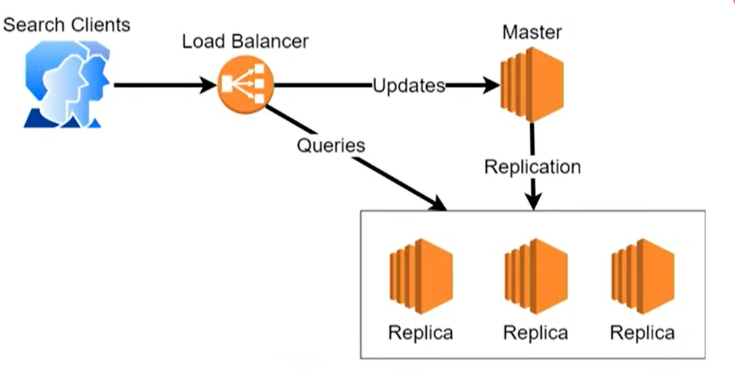
Solr Initial Architecture

Slide 4
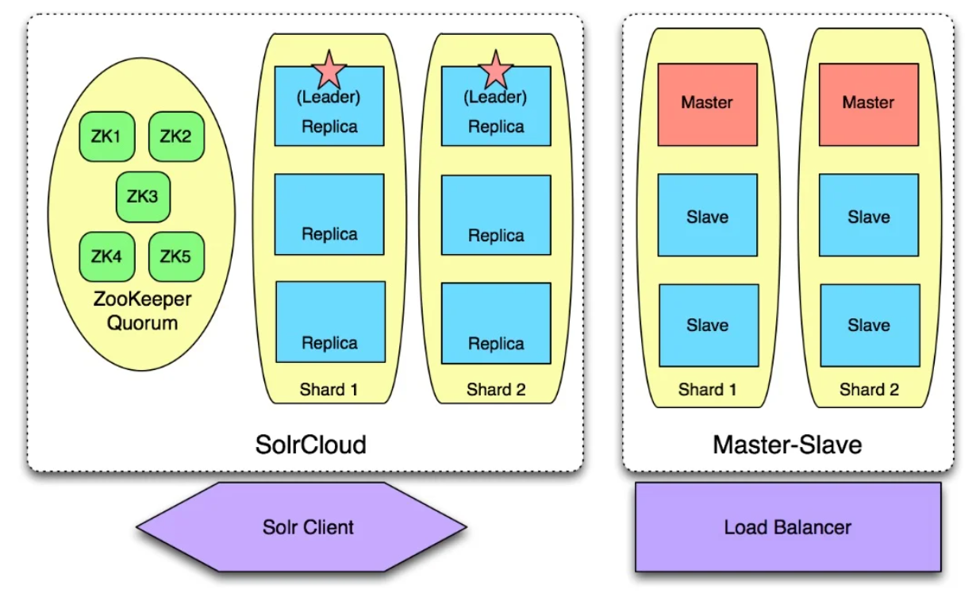
Solr Initial Architecture

Slide 5
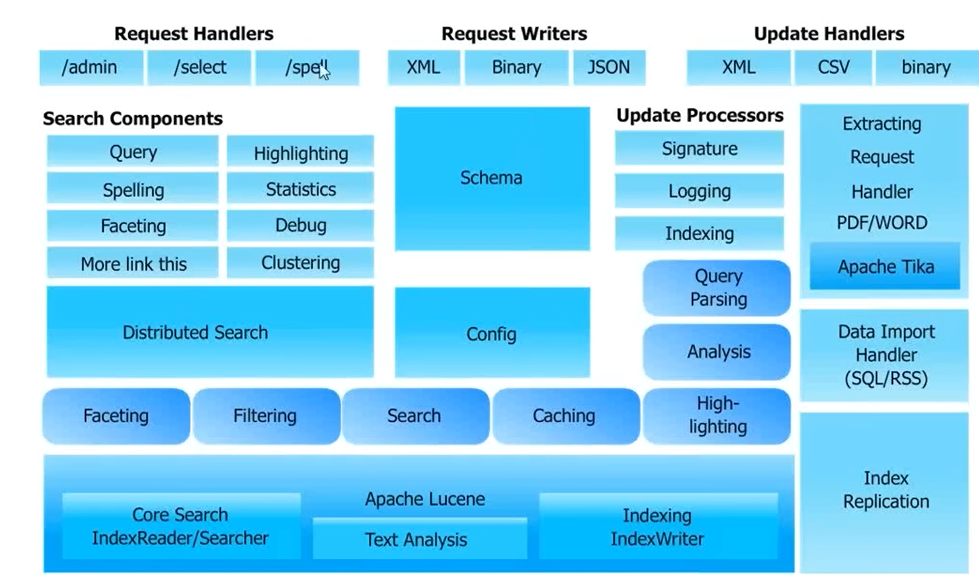
Solr Architecture

Slide 6
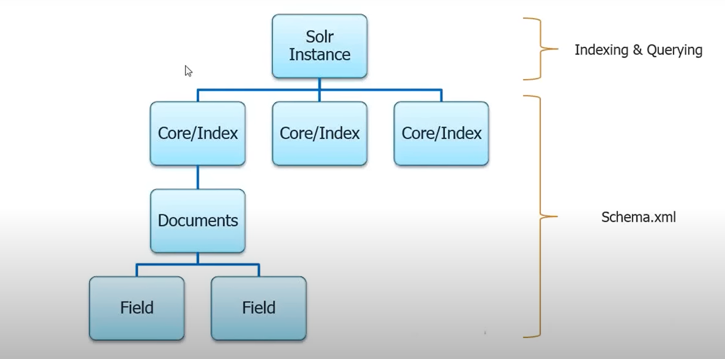
Solr Schema Hierarchy

Slide 7
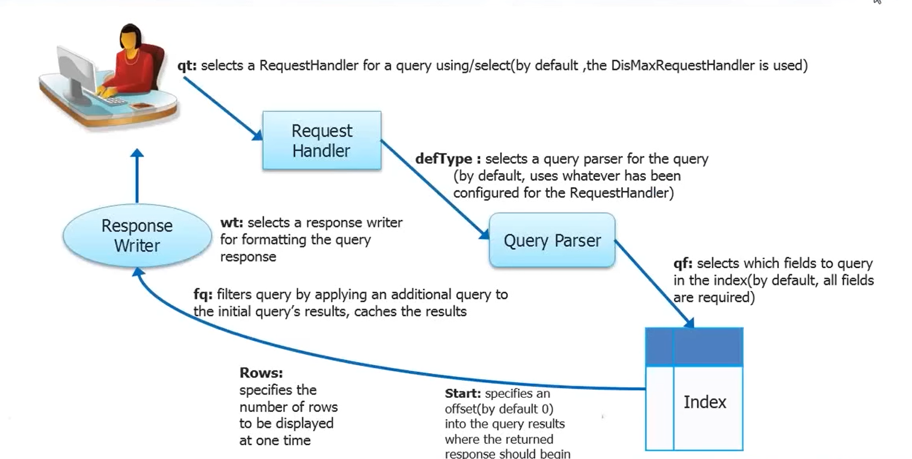
Solr Search Process

Slide 8
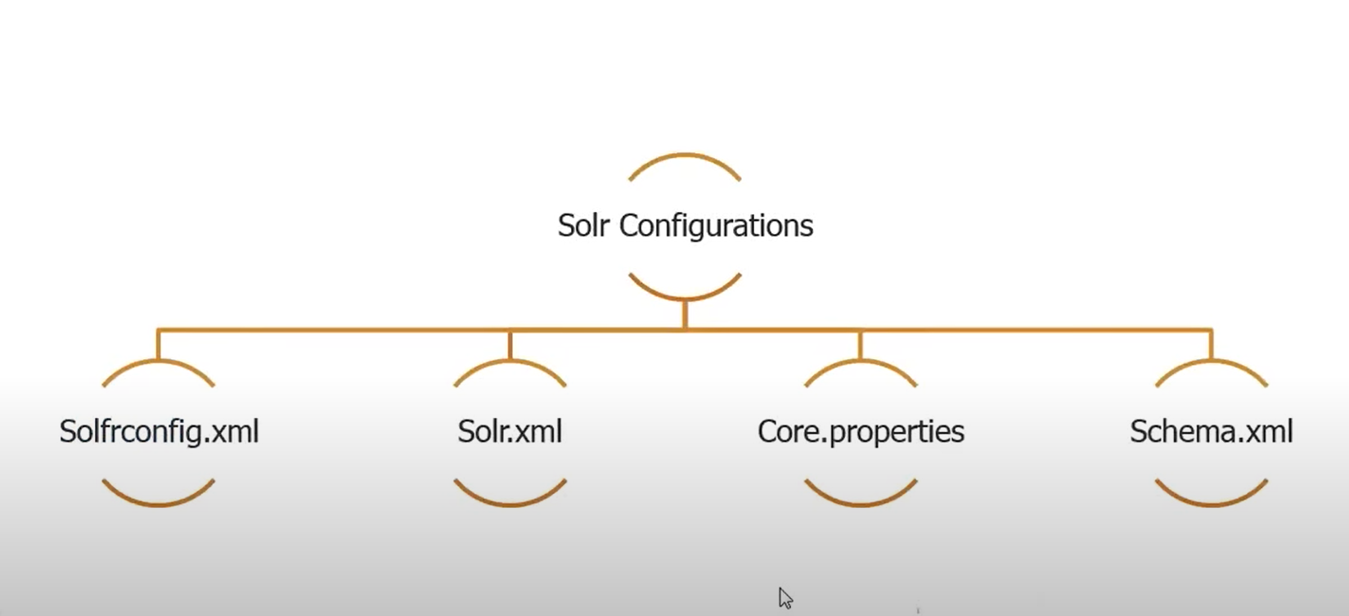
Configuring Solr Instances/Core

Slide 9
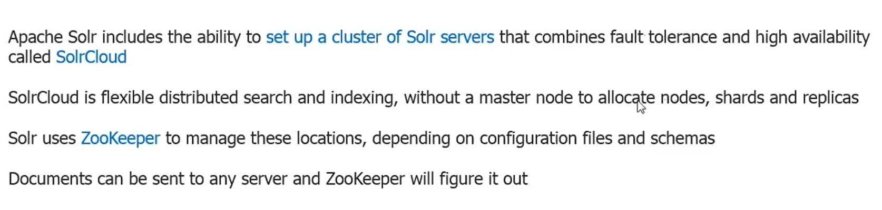
Solr Cloud

Slide 10
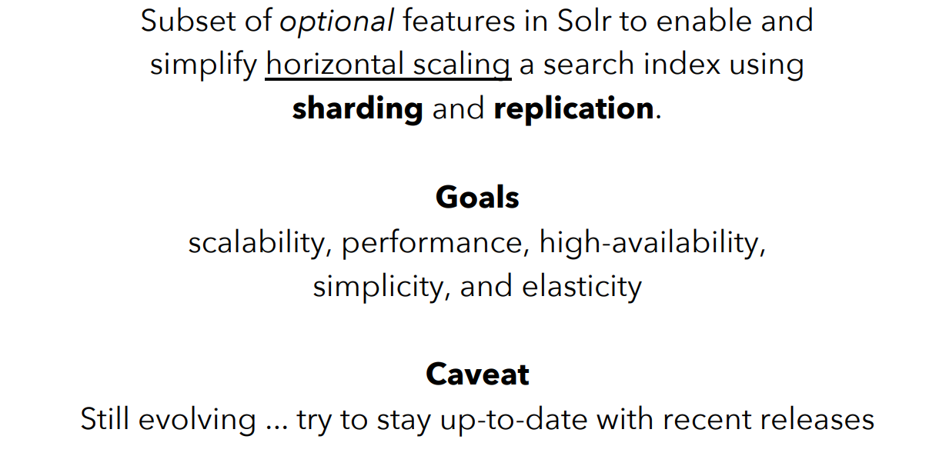
Solr Cloud

Slide 11
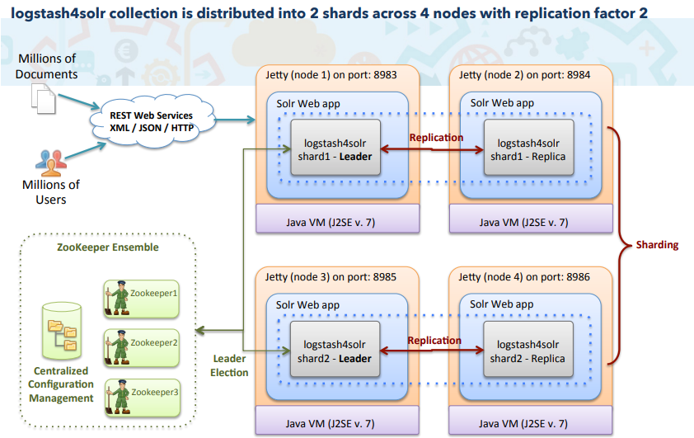
Solr Cloud High Level Architecture

Slide 12
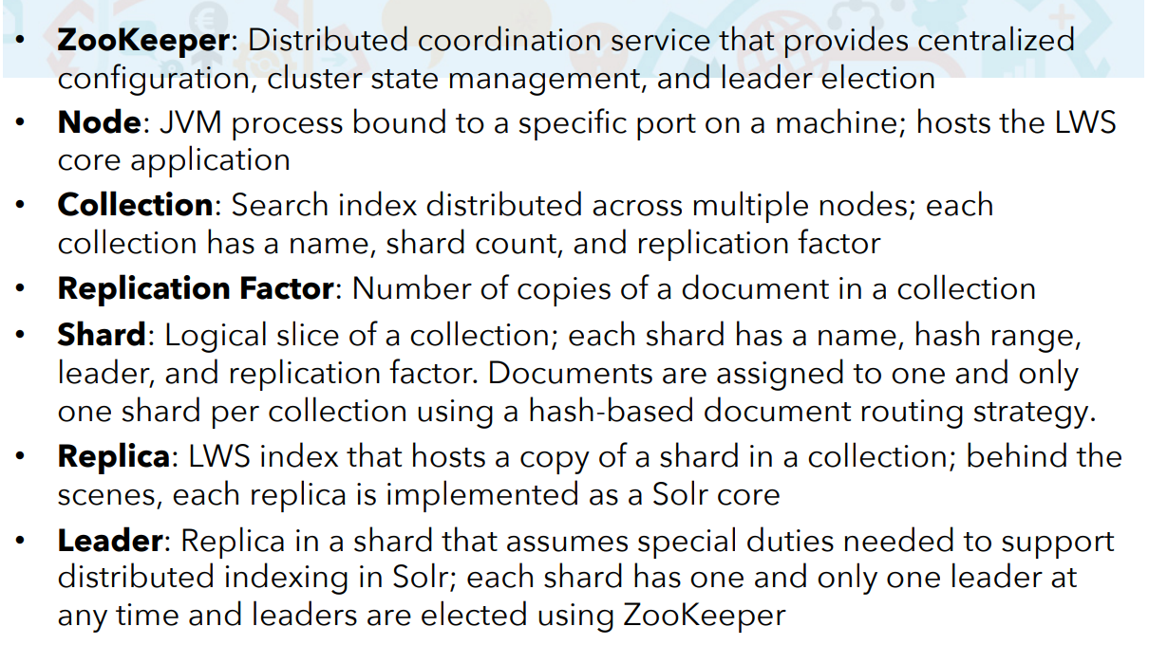
Solr Cloud

Slide 13
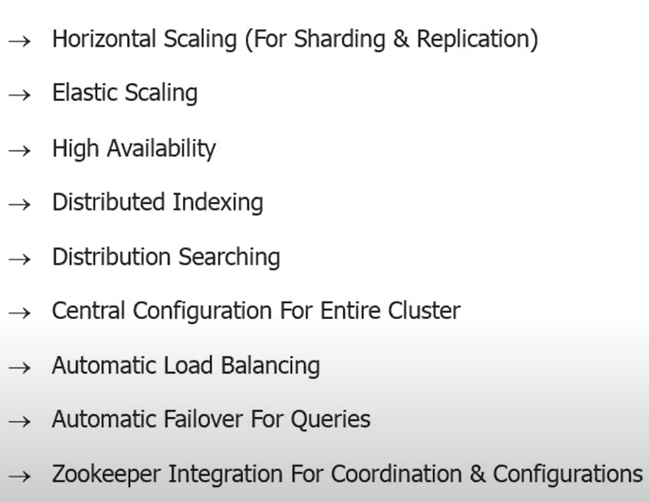
Solr Cloud Features

Slide 14
Solr Cloud
Apache Solr includes the ability to set up a cluster of Solr servers that combines fault tolerance and high availability.
Solr Cloud provides distributed indexing and search capabilities, supporting the following features:
Central configuration for the entire cluster
Automatic load balancing and fail-over for queries
ZooKeeper integration for cluster coordination and configuration.

Slide 15
Solr Cloud
Solr Cloud is flexible distributed search and indexing, without a master node to allocate nodes, shards and replicas.
Instead, Solr uses Zookeeper to manage these locations, depending on configuration files and schemas.
Queries and updates can be sent to any server.
Solr will use the information in the ZooKeeper database to figure out which servers need to handle the request.

Slide 16
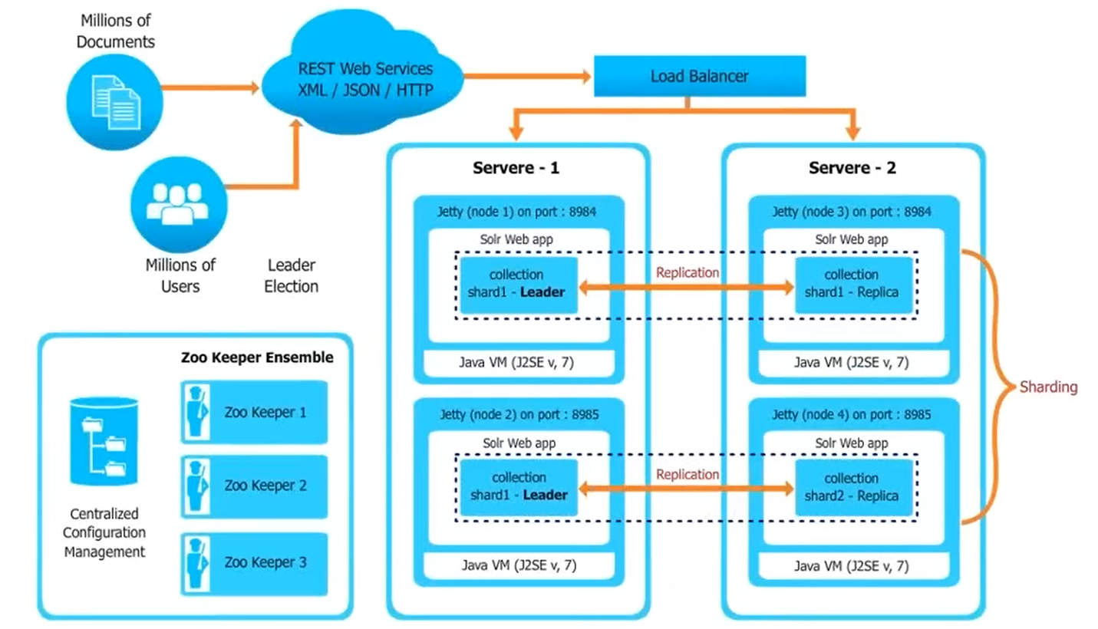
Solr Cloud Architecture

Slide 17
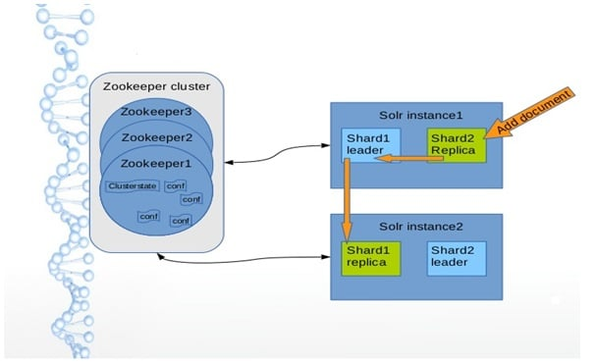
Solr Cloud Architecture

Slide 18
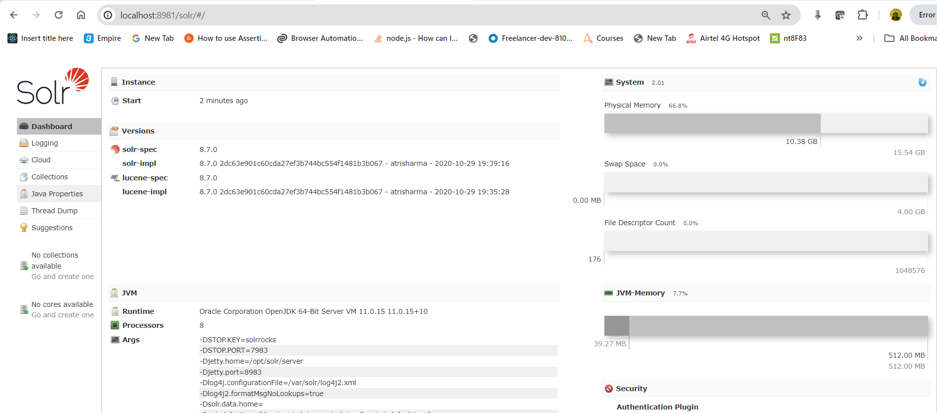
Solr Cloud

Slide 19
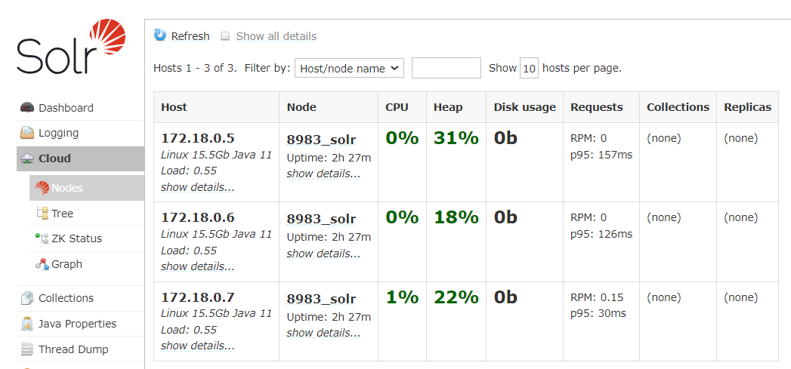
Solr Cloud

Slide 20
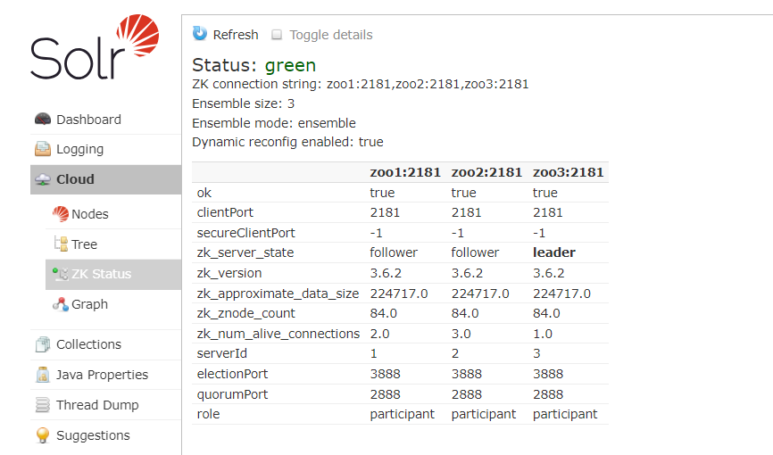
Solr Cloud

Slide 21
Solr Cloud Configuration and Parameters
Setting Up an External ZooKeeper Ensemble
Using ZooKeeper to Manage Configuration Files
ZooKeeper Access Control
Collections API
Parameter Reference
Command Line Utilities
SolrCloud with Legacy Configuration Files
ConfigSets API

Slide 22
Setting Up an External ZooKeeper Ensemble
How Many ZooKeeper Nodes?
Download Apache ZooKeeper
ZooKeeper Installation
Configuration for a ZooKeeper Ensemble
Initial Configuration
Ensemble Configuration
ZooKeeper Environment Configuration
More Information about ZooKeeper
Starting and Stopping ZooKeeper
Start ZooKeeper
Shut Down ZooKeeper

Slide 23
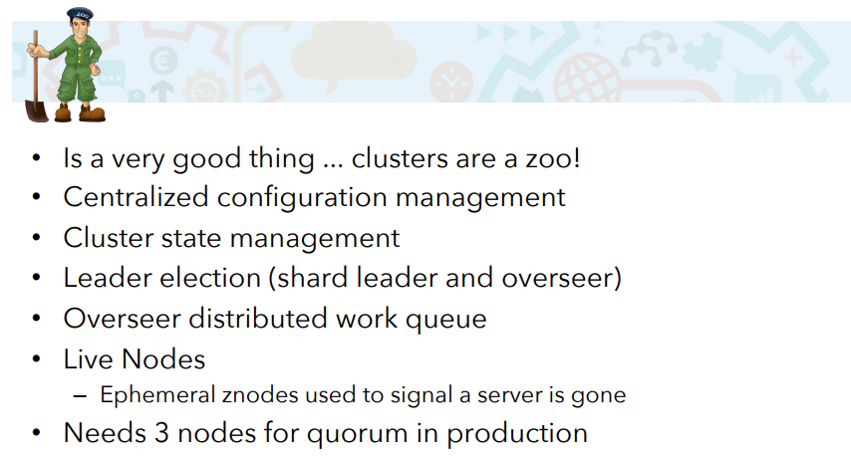
Setting Up an External ZooKeeper Ensemble

Slide 24
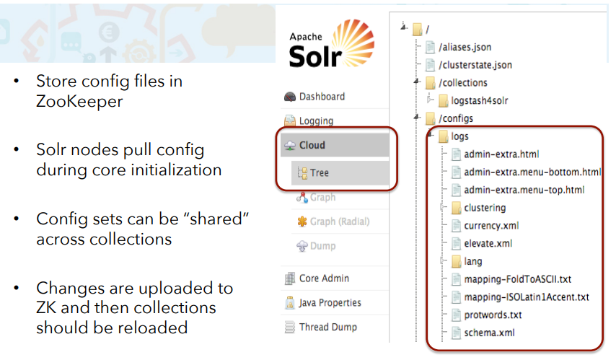
ZooKeeper Centralized Configuration

Slide 25
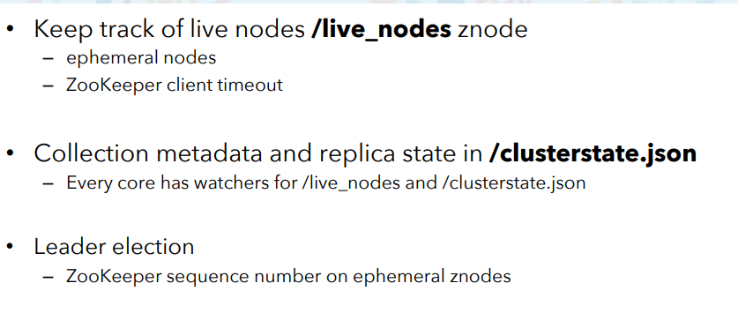
ZooKeeper Centralized Configuration

Slide 26
Setting Up an External ZooKeeper Ensemble
Solr Configuration
Using a chroot
Using the -z Parameter with bin/solr
Updating Solr’s Include Files
Increasing the File Size Limit
Configuring jute.maxbuffer on ZooKeeper Nodes
Configuring jute.maxbuffer for ZooKeeper Clients
Securing the ZooKeeper Connection

Slide 27
How Many ZooKeeper Nodes?
ZooKeeper ensemble is maintaining most servers to serve requests.
For a ZooKeeper service to be active, there must be most non-failing machines that can communicate with each other.
To create a deployment that can tolerate the failure of F machines, you should count on deploying 2xF+1 machines.
If we have three ZooKeeper nodes and one goes down, we have 66% of our servers available.
ZooKeeper will continue normally while we repair the one down node.
If we have 5 nodes, we could continue operating with two down nodes if necessary.

Slide 28
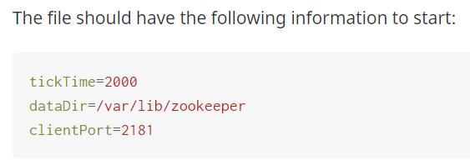
Configuration for a ZooKeeper Ensemble
Initial Configuration
To configure your ZooKeeper instance, create a file named <ZOOKEEPER_HOME>/conf/zoo.cfg.
A sample configuration file is included in our ZooKeeper installation, as conf/zoo_sample.cfg.
We can edit and rename that file instead of creating it new if we prefer.

Slide 29
Configuration for a ZooKeeper Ensemble
tickTime
Part of what ZooKeeper does is determine which servers are up and running at any given time, and the minimum session time out is defined as two "ticks".
The tickTime parameter specifies in milliseconds how long each tick should be.
dataDir
This is the directory in which ZooKeeper will store data about the cluster.
This directory must be empty before starting ZooKeeper for the first time.
clientPort
This is the port on which Solr will access ZooKeeper.

Slide 30
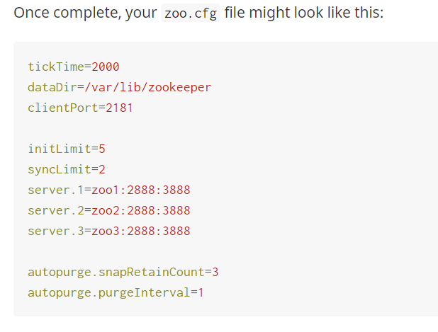
Ensemble Configuration
To complete configuration for an ensemble, we need to set additional parameters.
So each node knows who it is in the ensemble and where every other node is.

Slide 31
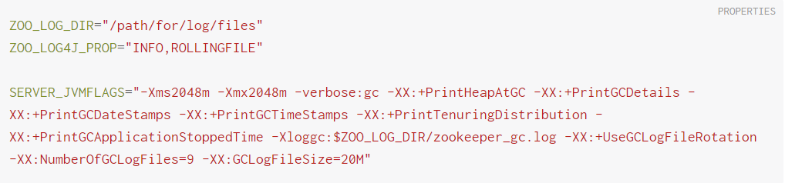
ZooKeeper Environment Configuration
Create a file named zookeeper-env.sh and put it in the <ZOOKEEPER_HOME>/conf directory (the same place you put zoo.cfg).
This file will need to exist on each server of the ensemble.
Add the following settings to the file:
Review the default settings in <ZOOKEEPER_HOME>/conf/log4j.properties, especially the log4j.appender.ROLLINGFILE.MaxFileSize parameter.
This sets the size at which log files will be rolled over, and by default it is 10MB.
Copy zookeeper-env.sh and any changes to log4j.properties to each server in the ensemble.

Slide 32
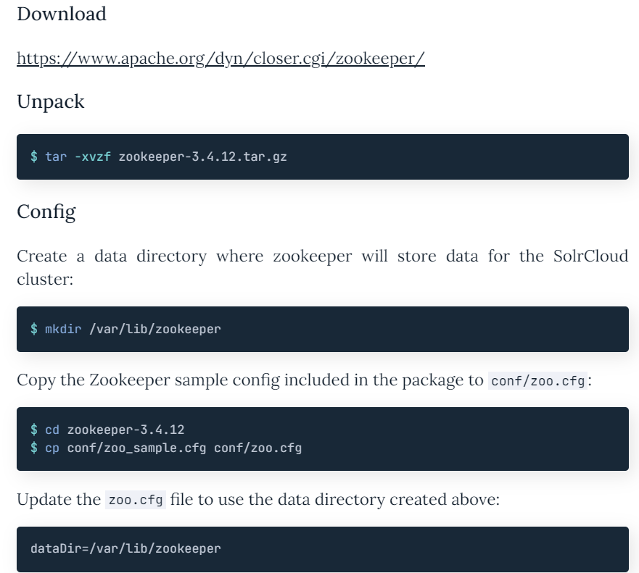
Solr Cloud Local

Slide 33
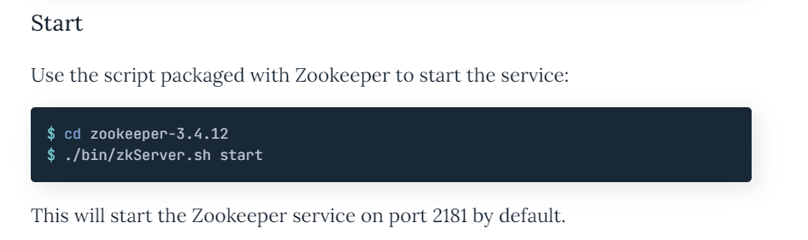
Solr Cloud Local
Zkserver.cmd

Slide 34
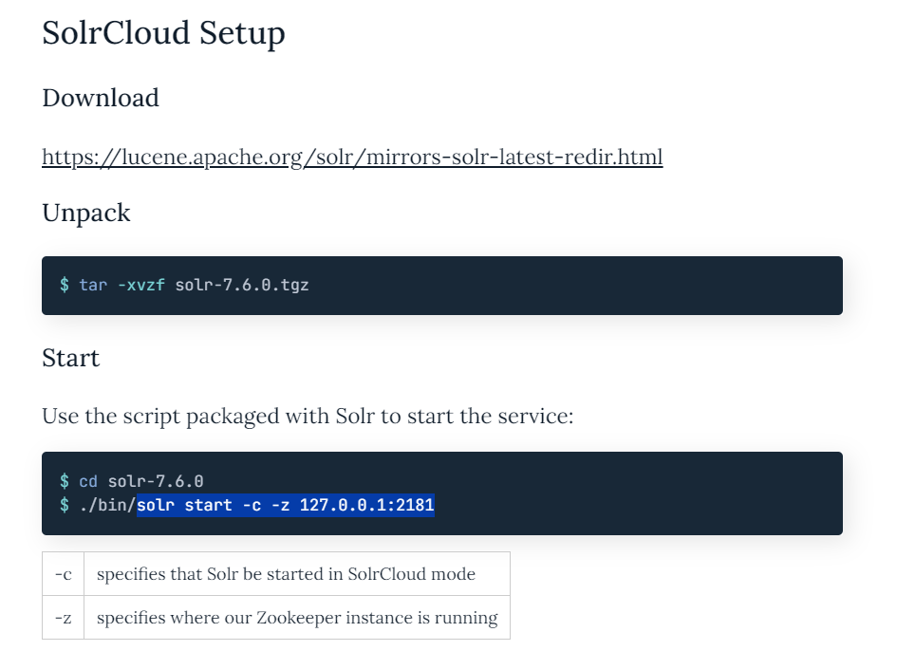
Solr Cloud Local
Zkserver.cmd

Slide 35
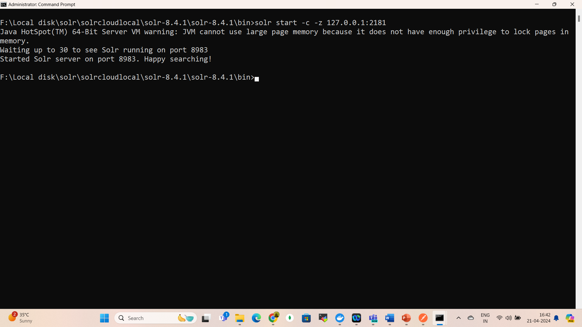
Solr Cloud Local
solr start –c –z 127.0.0.1:2181
Zkserver.cmd

Slide 36
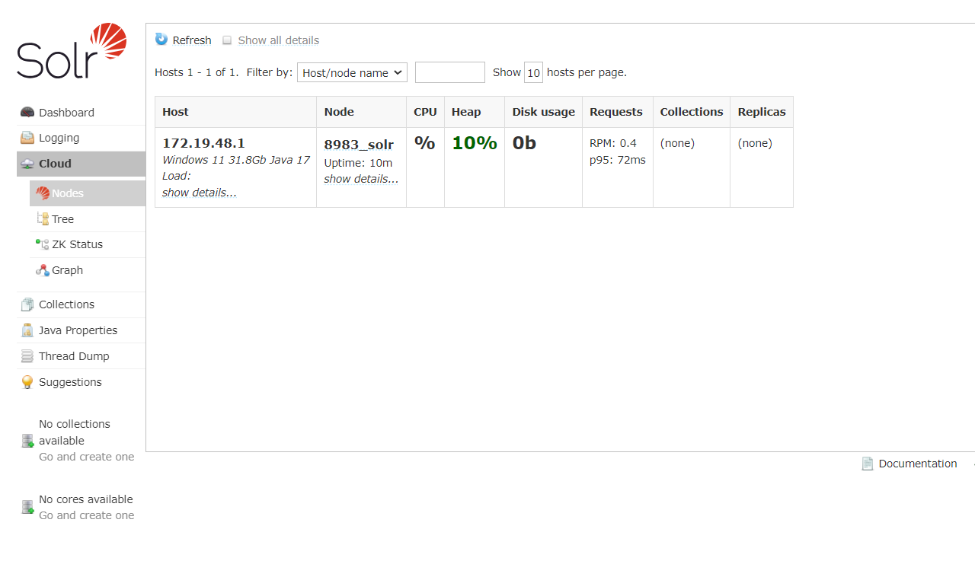
Solr Cloud Local
Zkserver.cmd

Slide 37
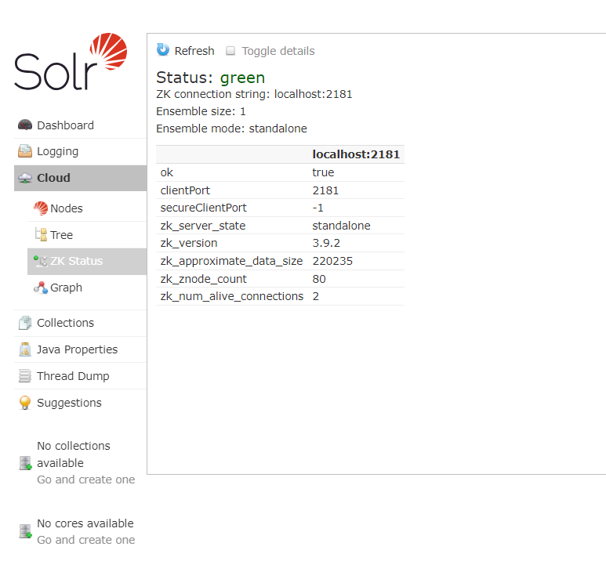


Solr Cloud Local - Verify
Zkserver.cmd

Slide 38
Solr Cloud Local -Create a Search Collection
Upload Config To ZooKeeper
Solr comes packaged with a default collection configuration that essentially works as “schemaless”, meaning that fields do not need to be explicitly defined.
Solr will attempt to guess field types on import.
This is the config we are going to use for this setup.
Use the built-in Solr script to upload the config set to Zookeeper

Slide 39
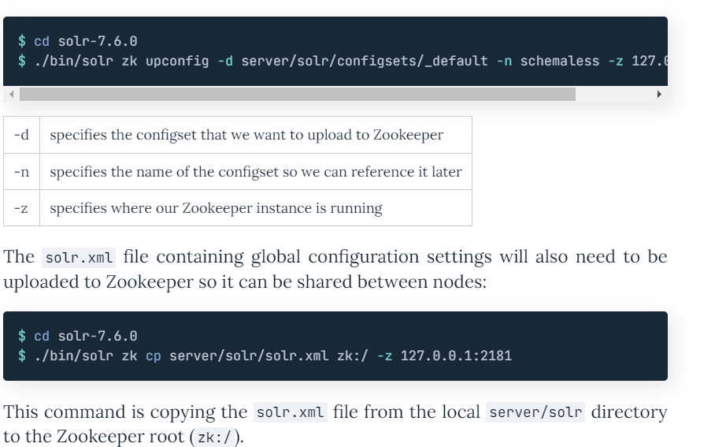
Solr Cloud Local -Create a Search Collection
solr zk upconfig -d ../server/solr/configsets/_default -n schemaless -z 127.0.0.1:2181

Slide 40
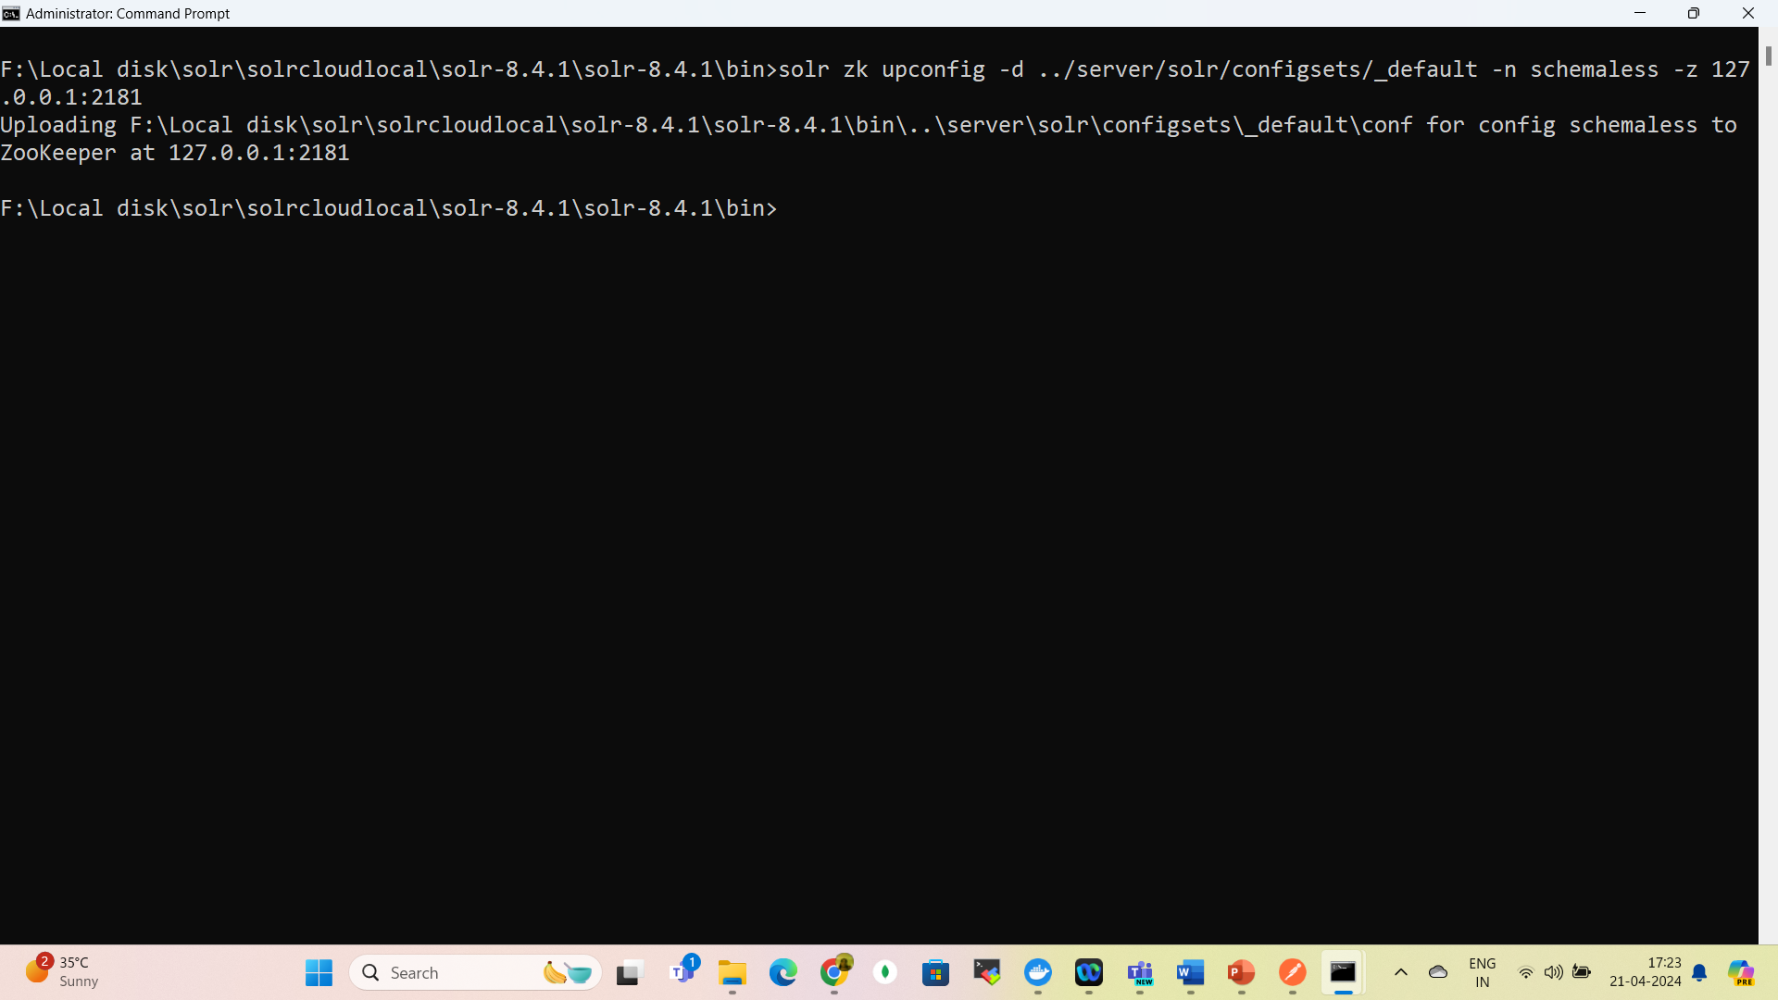
Solr Cloud Local -Create a Search Collection
solr zk upconfig -d ../server/solr/configsets/_default -n schemaless -z 127.0.0.1:2181

Slide 41
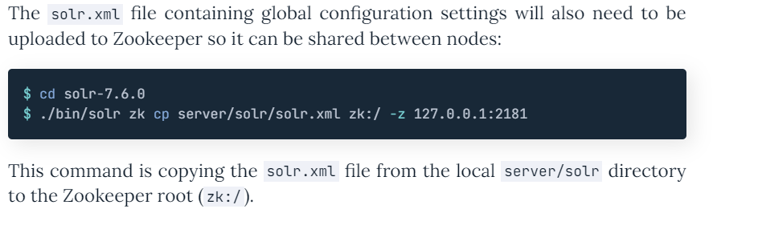
Solr Cloud Local -Create a Search Collection

Slide 42
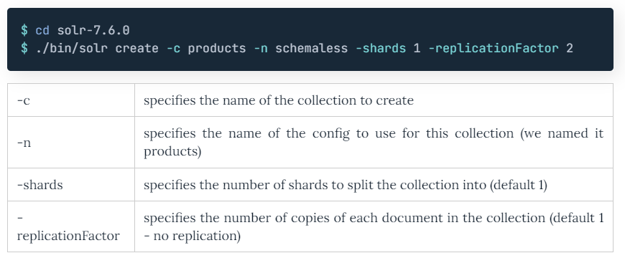
Solr Cloud Local -Create SolrCloud Collection

Slide 43
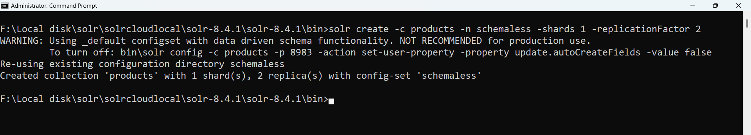
Solr Cloud -Create SolrCloud Collection
solr create -c products -n schemaless -shards 1 -replicationFactor 2

Slide 44
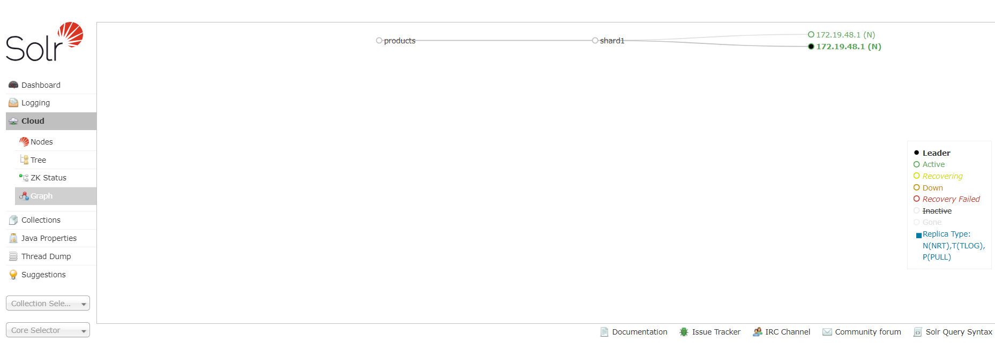
Solr Cloud Local - Verify

Slide 45
Solr Cloud Local – Import Data
We are going to import some of the sample data that comes packaged with Solr.
So, we have something to play with and to verify data is being synchronized between nodes.
The JSON format which Solr accepts is just an array of objects.
Hence if you have our own data feel free to use that.

Slide 46
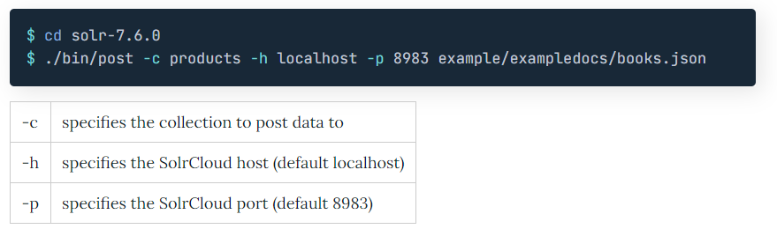
Solr Cloud Local – Import Data

Slide 47
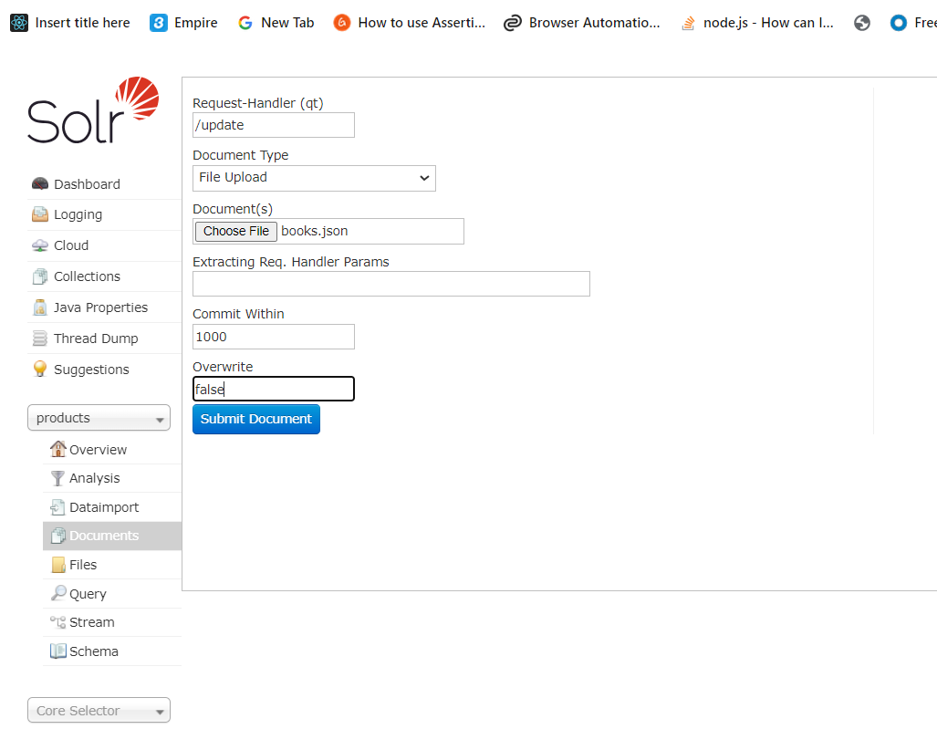
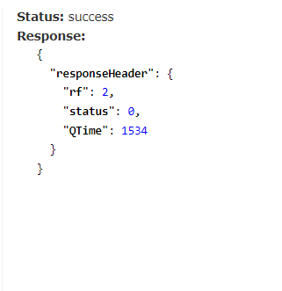
Solr Cloud Local – Import Data

Slide 48
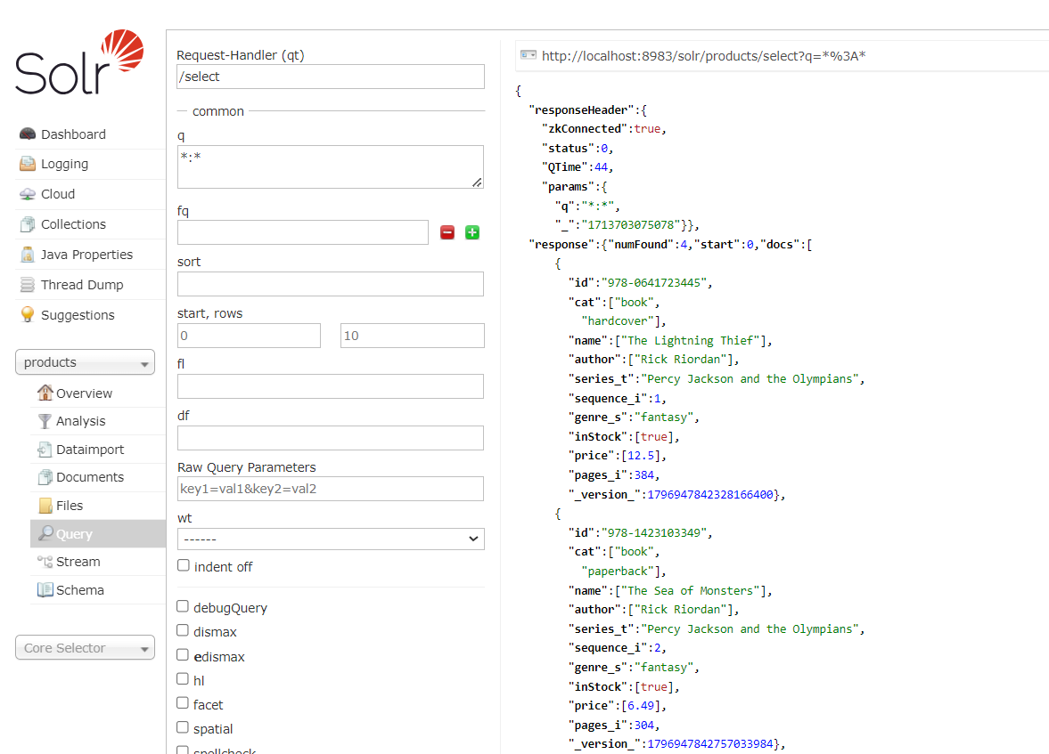
Solr Cloud Local – Query Data

Slide 49
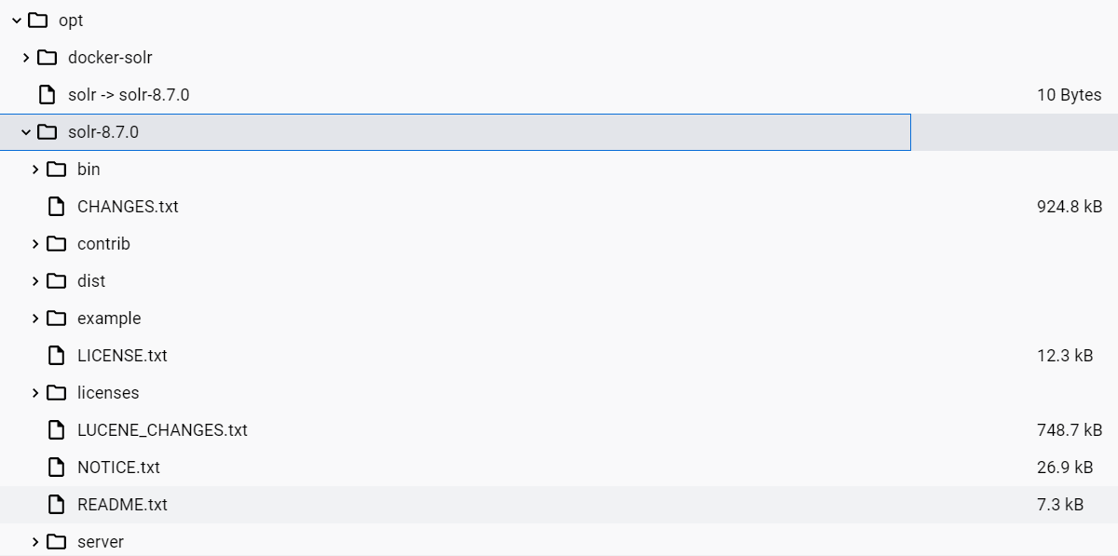
Solr Cloud

Slide 50
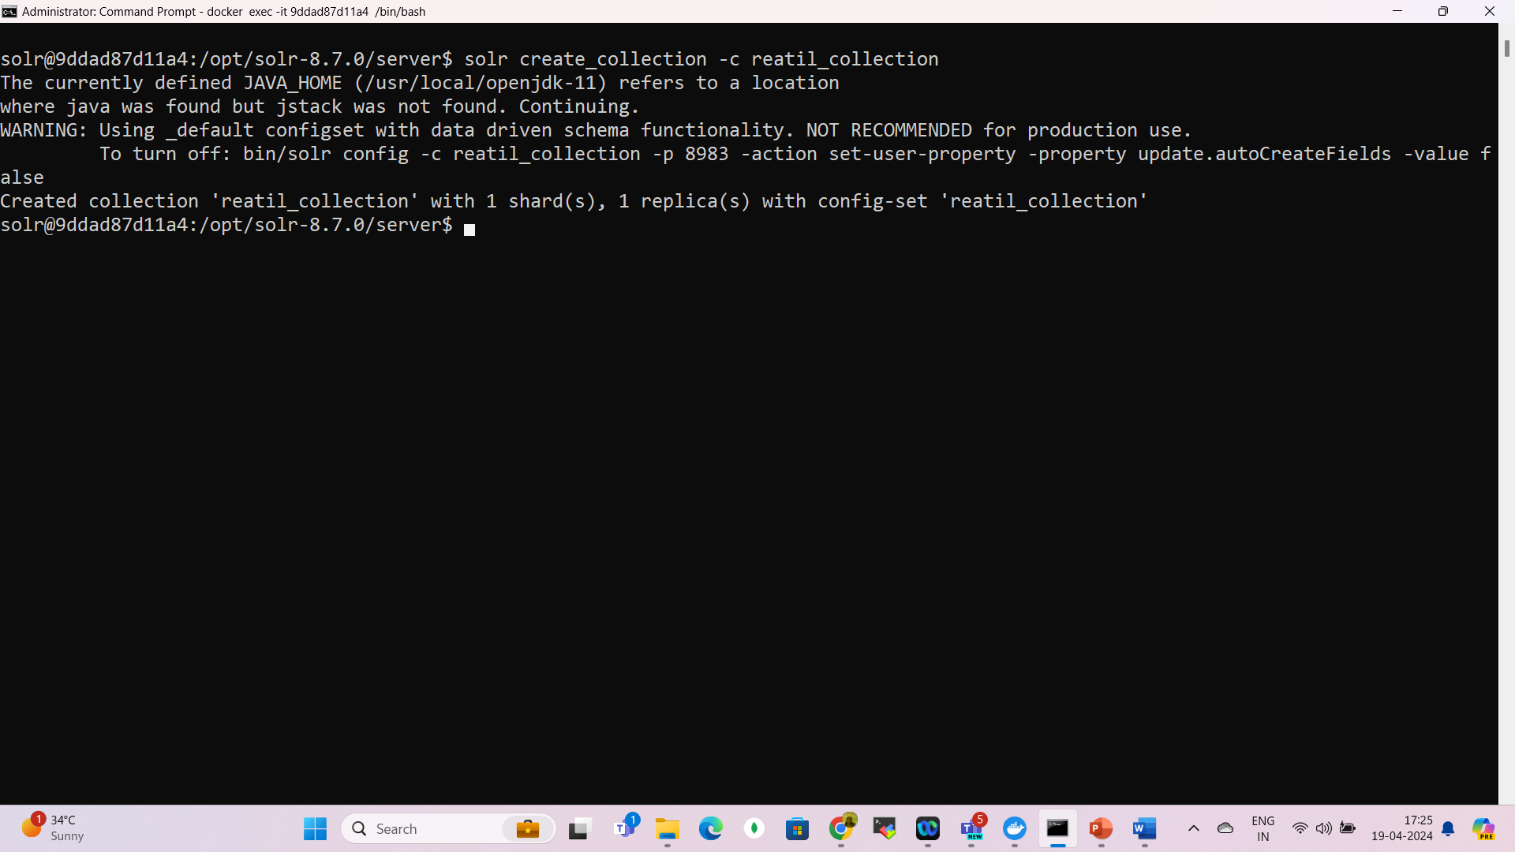
Solr Cloud

Slide 51
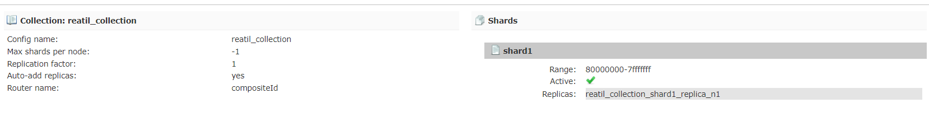
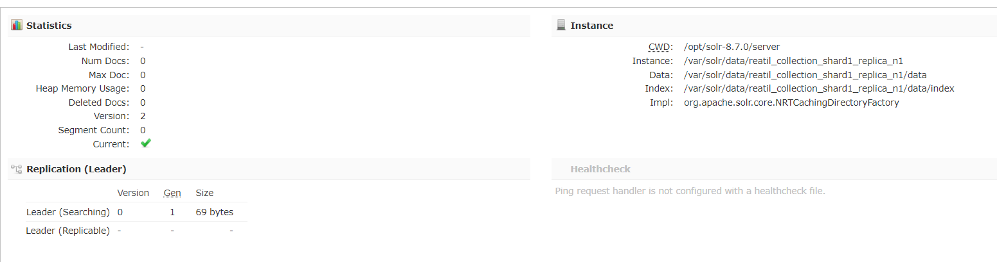
Solr Cloud

Slide 52
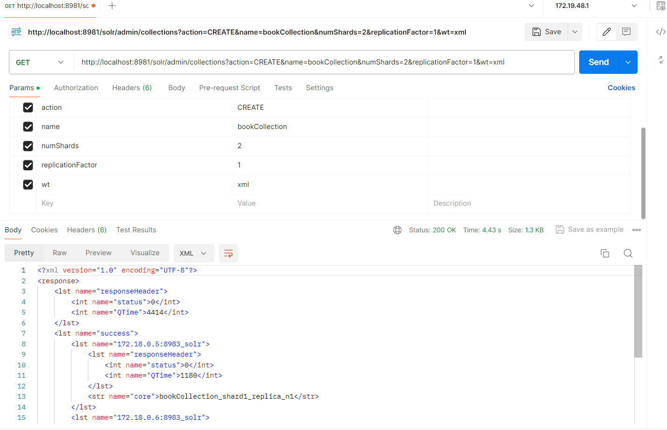
Solr Cloud – create collection

Slide 53
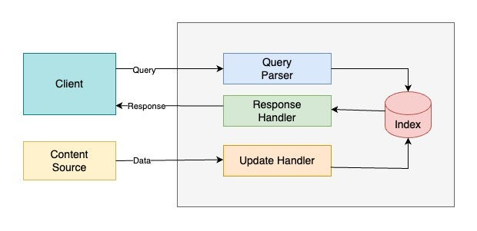
Solr Cloud – create collection

Slide 54
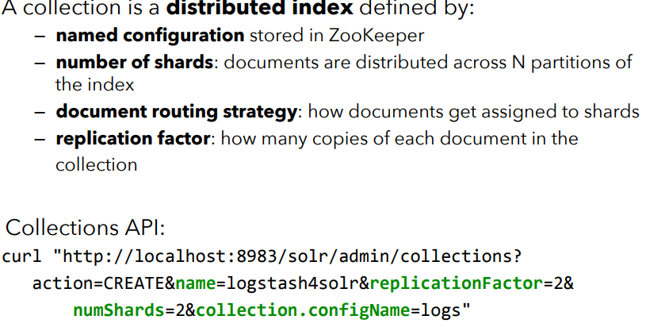
Solr Cloud – create collection

Slide 55
Solr Cloud – create collection
Index
Apache Solr Index is the “database” for managing structured/unstructured data.
It stores data in a way that makes analysis and full text search easier.
Query Parser
All queries submitted by client is handled by Query parser.

Slide 56
Solr Cloud – create collection
Response Handler
Response handler is responsible for generating response is appropriate format (json/xml/csv) for client.
Update Handler
It is used for indexing; i.e insertion, updation, Deletion of Data in Index.
For example if we want our MySQL data to be in sync with Apache Solr, we have to create an Update Handler responsible fo sync.

Slide 57
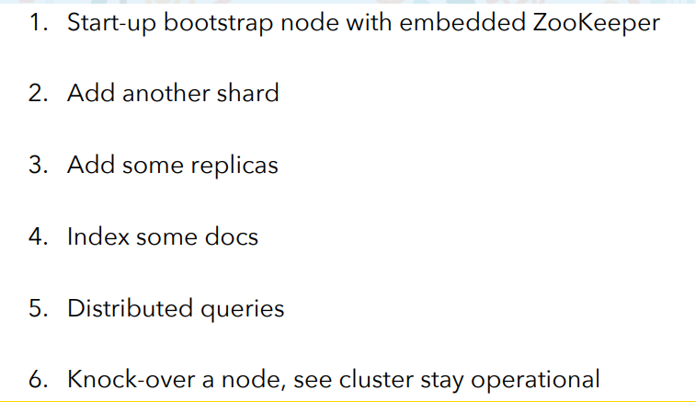
Solr Cloud – Demo

Slide 58
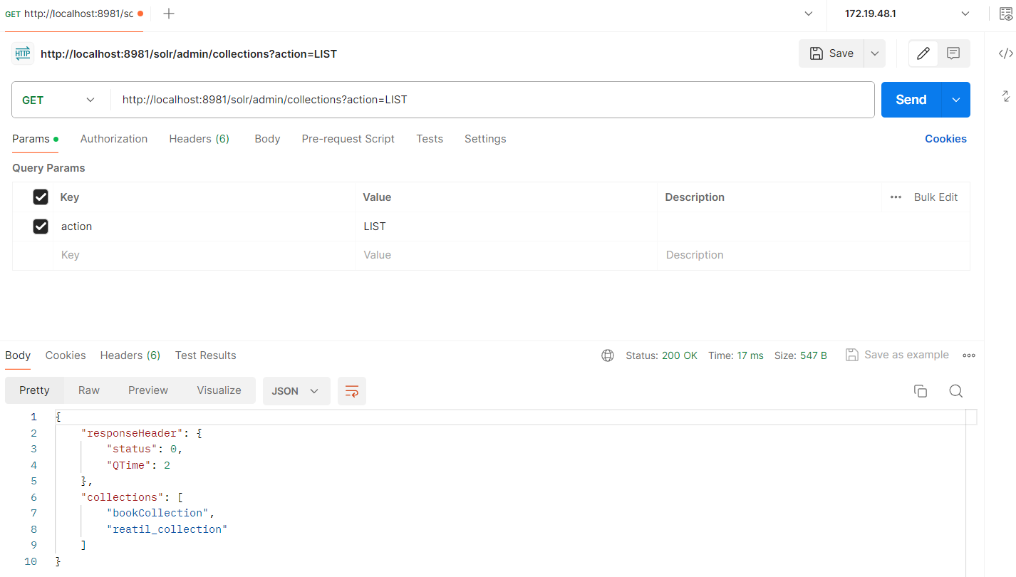
Solr Cloud List Collection

Slide 59
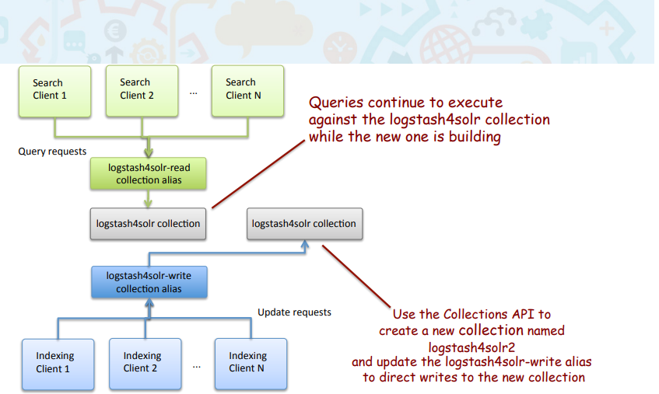
Solr Collection Aliases

Slide 60
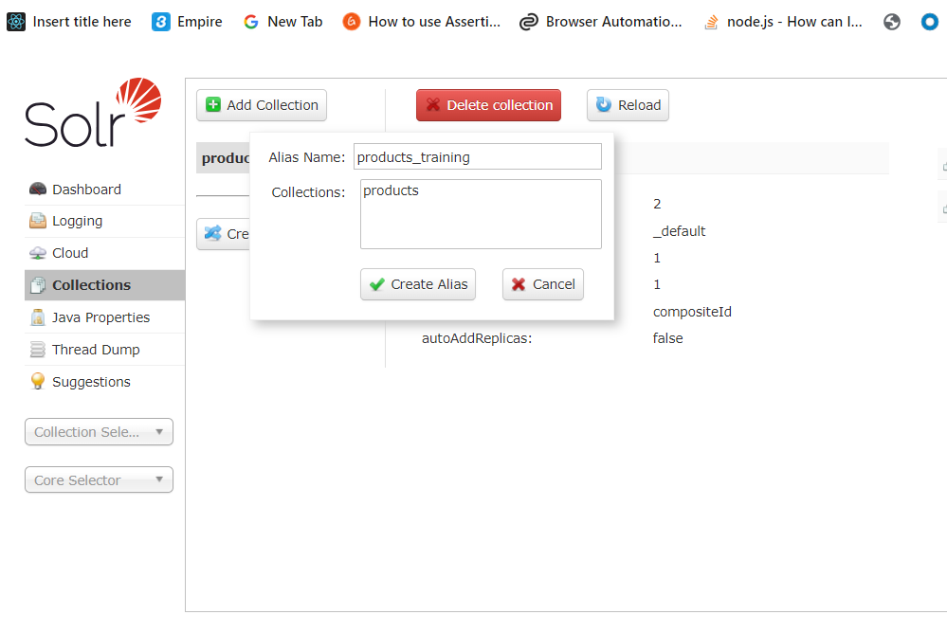
Solr Collection Aliases

Slide 61
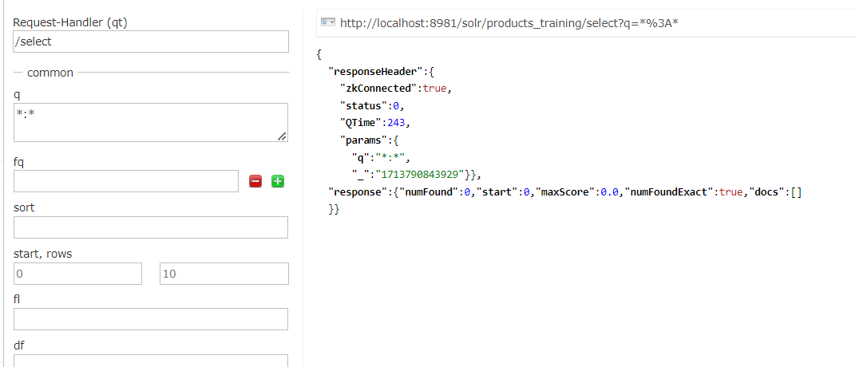
Solr Collection Aliases

Slide 62
Ingestion Approaches
Ingestion is the process of importing external data into Solr index.
There are atleast 3 ways :
For binary files(pdf/doc etc), we can use tools like Solr Cell
For XML Files we can send HTTP requests
For custom ingestion we may write our own program using Solr Client API.

Slide 63


Facets and Constraints
Solr supports faceting.
Faceting means arrangement of search results into categories.
A Facet represents search result category.
Constraints are the facet values.
Constraints

Slide 64

Facets and Constraints

Slide 65

Create schema

Slide 66

Update schema

Slide 67

Update schema

Slide 68

Update schema

Slide 69

Update schema

Slide 70

Solr Cloud Local With N nodes interactive way
Solr –e cloud

Slide 71

Solr Cloud Local With N nodes interactive way
Solr –e cloud

Slide 72
How Solr Cloud Works

Slide 73
Key Solr Cloud Concepts
A Solr Cloud cluster consists of some "logical" concepts layered on top of some "physical" concepts.
Cloud Cluster
Logical
Physical

Slide 74
Key Solr Cloud Concepts
Logical
A Cluster can host multiple Collections of Solr Documents.
A collection can be partitioned into multiple Shards, which contain a subset of the Documents in the Collection.
The number of Shards that a Collection has determines:
The theoretical limit to the number of Documents that Collection can reasonably contain.
The amount of parallelization that is possible for an individual search request.

Slide 75
Key Solr Cloud Concepts
Physical
A Cluster is made up of one or more Solr Nodes, which are running instances of the Solr server process.
Each Node can host multiple Cores.
Each Core in a Cluster is a physical Replica for a logical Shard.
Every Replica uses the same configuration specified for the Collection that it is a part of.
The number of Replicas that each Shard has determines:
The level of redundancy built into the Collection and how fault tolerant the Cluster can be in the event that some Nodes become unavailable.
The theoretical limit in the number concurrent search requests that can be processed under heavy load.

Slide 76

Shards and Indexing Data in SolrCloud

Slide 77
Shards and Indexing Data in SolrCloud
When our collection is too large for one node, we can break it up and store it in sections by creating multiple shards.
A Shard is a logical partition of the collection, containing a subset of documents from the collection.
It ensures every document in a collection is contained in exactly one Shard.
Which shard contains each document in a collection depends on the overall "Sharding" strategy for that collection.
For example, we might have a collection where the "country" field of each document determines which shard it is part of, so documents from the same country are co-located.
A different collection might simply use a "hash" on the uniqueKey of each document to determine its Shard.

Slide 78
Shards and Indexing Data in SolrCloud
Before SolrCloud, Solr supported Distributed Search, which allowed one query to be executed across multiple shards.
The query was executed against the entire Solr index and no documents would be missed from the search results.

Slide 79

Shards and Indexing Data in SolrCloud

Slide 80
Shards and Indexing Data in SolrCloud
There were, however, several problems with the distributed approach that necessitated improvement with SolrCloud:
Splitting an index into shards was somewhat manual.
There was no support for distributed indexing
Hence, we needed to explicitly send documents to a specific shard.
Solr couldn’t figure out on its own what shards to send documents to.
There was no load balancing or failover.
So, if we got a high number of queries, we needed to figure out where to send them and if one shard died it was just gone.

Slide 81
Shards and Indexing Data in SolrCloud
Solr Cloud fixes all those problems.
There is support for distributing both the index process and the queries automatically.
ZooKeeper provides failover and load balancing.
Additionally, every shard can also have multiple replicas for additional robustness.
In Solr Cloud there are no masters or slaves. Instead, every shard consists of at least one physical replica, exactly one of which is a leader.

Slide 82

Leaders

Slide 83

Replication

Slide 84
Shards and Indexing Data in SolrCloud
Leaders are automatically elected, initially on a first-come-first-served basis, and then based on the ZooKeeper process.
If a leader goes down, one of the other replicas is automatically elected as the new leader.
When a document is sent to a Solr node for indexing, the system first determines which Shard that document belongs to.
Then which node is currently hosting the leader for that shard.
The document is then forwarded to the current leader for indexing, and the leader forwards the update to all of the other replicas.

Slide 85

Solr vs ELK

Slide 86

Solr vs OpenSearch

Slide 87

Solr vs OpenSearch

Slide 88

Solr vs OpenSearch

Slide 89
Solr vs Lucene
Lucene | Solr
Lucene is primarily a Java library that provides indexing and querying functionalities to build search applications. | Solr is built on top of Lucene
It focuses on providing a low-level API for full-text indexing and searching | provides a ready-to-use search platform with additional features such as distributed searching, caching, faceted search, and more.
Lucene is a library that can be directly integrated into a Java application to add indexing and searching capabilities. It works at a lower level, allowing developers to have fine-grained control over the search process. | , Solr provides a standalone server with a REST-like API that can be used to interact with the search engine. It simplifies the process of building search applications and provides a ready-to-use platform.

Slide 90
Solr vs Lucene
Lucene | Solr
Lucene, being a library, can also be used in a distributed environment, but it requires more manual configuration and setup. | Solr is designed to handle large-scale deployments and distributed searching out of the box. It can distribute indexing and querying across multiple machines for improved performance and fault tolerance.
These features are built on top of Lucene's core functionality and provide a high-level abstraction for developers. | Solr extends the capabilities of Lucene by providing additional features such as faceted search, highlighting, spell checking, document processing, support for different data sources, and more.
Lucene is a library that can be directly integrated into a Java application to add indexing and searching capabilities. It works at a lower level, allowing developers to have fine-grained control over the search process. | , Solr provides a standalone server with a REST-like API that can be used to interact with the search engine. It simplifies the process of building search applications and provides a ready-to-use platform.

Slide 91
Solr vs Lucene
Lucene | Solr
Lucene, being a library, requires more coding and configuration to build a search application from scratch. | Solr provides a ready-to-use search platform with an out-of-the-box configuration, making it easier for developers to get started..
 | It has rich documentation and a user-friendly interface for configuration and monitoring.
 | Both Lucene and Solr have active open-source communities, but Solr has a larger user base and a more robust support ecosystem. It has a wider range of plugins, extensions, and third-party integrations available, making it easier to find solutions to common problems.

Slide 92
Solr Indexing best practices
Key Challenges/Points
Read/Write Scalability.
Disaster Recovery.
Data Replication.
Index Data Backup.
Solr Schema Changes, without downtime.
Handling full indexing — Delete all data and reingest.
Solr Commit Settings during indexing — full-indexing.

Slide 93
Apache Solr indexing performance
Hardware considerations:
Memory
Solr relies heavily on memory for caching frequently used data.
Allocate at least 50% of your server's memory to Solr, but the exact amount will depend on the size of your dataset and your query patterns.
Use the Solr GC logs to monitor memory usage, and ensure that the JVM heap size is appropriately configured in 'solrconfig.xml'.
In solr environments, Set the starting and maximum JVM heap size to the same value.
Xms<size> Sets the initial heap size e.g. -Xms=8g
Xmx<size> Sets the maximum heap size e.g. -Xmx=8g

Slide 94
Apache Solr indexing performance
Hardware considerations:
Storage
Use SSDs (Solid-State Drives) rather than HDDs (Hard Disk Drives) for your Solr data.
SSDs provide faster read and write speeds, which are crucial for efficient indexing.
Monitor disk space regularly to prevent running out of storage, as it can lead to indexing errors and corrupted index segment files.

Slide 95
Apache Solr indexing performance
Hardware considerations:
CPU
Solr can take advantage of multi-core CPUs for parallel processing of indexing tasks.
Ensure your server has enough CPU cores to handle concurrent indexing requests effectively.
Monitor CPU usage, and if it's consistently high, consider adding more CPU cores or optimizing your indexing process to be more efficient.

Slide 96
Indexing practices
Batch indexing
Utilize tools like DataImportHandler (DIH) for importing data in bulk from databases or SolrJ for programmatic indexing.
Consider using Solr's delta-import functionality to update only the changed data, reducing the indexing load.

Slide 97

Indexing practices

Slide 98

Indexing practices
F:\Local disk\solr\solrcloudlocal\solr-8.4.1\solr-8.4.1\example\example-DIH

Slide 99
Partial Index
https://solr.apache.org/guide/solr/latest/indexing-guide/partial-document-updates.html

Slide 100
Partial Index
{
"id":"emp-009",
"name":["AShutosh"],
"department":["Marketing"],
"designation":["Executive"],
"experience":[2],
"_version_":1797089602829287424}
{
"id":"emp-009",
"name":{"set":"Parameswari"},
"department":{"add":["Marketing","Development"]}
"designation":{"remove":"executive"},
"experience":[2],
"_version_":1797089602829287424}

Slide 101
Partial Index
"response":{"numFound":3,"start":0,"maxScore":1.0,"numFoundExact":true,"docs":[
{
"id":"emp-009",
"name":["Parameswari"],
"department":["Marketing",
"Marketing",
"Development"],
"designation":["Executive"],
"experience":[2],
"_version_":1797091585532362752},

Slide 102
Reindex
Reindex" in this context means first delete the existing index and repeat the process you used to ingest the entire corpus from the system-of-record.
It is strongly recommended that Solr users have a consistent, repeatable process for indexing so that the indexes can be recreated as the need arises

Slide 103
Reindex
Reindex" in this context means first delete the existing index and repeat the process you used to ingest the entire corpus from the system-of-record.
It is strongly recommended that Solr users have a consistent, repeatable process for indexing so that the indexes can be recreated as the need arises.
Reindexing is recommended during major upgrades

Slide 104
Indexing practices
Avoid over-indexing
Only index fields that are required for search and filtering.
Eliminate unnecessary indexed fields to reduce the index size and improve performance.
Minimise the use of dynamic fields to avoid unnecessary complexity.

Slide 105
Indexing practices
Optimize data
Clean and preprocess your data before indexing. This includes removing HTML tags, whitespace, and any non-essential content.
Utilize data transformation techniques, such as tokenization and stemming, to enhance the quality of the indexed data.

Slide 106
Indexing practices
Parallel indexing
Consider parallel indexing using multiple threads or Solr instances when dealing with a large volume of data.
This approach can significantly improve indexing speed and efficiency.
Ensure proper synchronization mechanisms to prevent data corruption when using parallel indexing.

Slide 107
Indexing practices
Delta updates
Delta updates are crucial for efficiently updating existing data in the index without reindexing the entire dataset.
Use the '_update' endpoint to apply changes incrementally.
Maintain a system for tracking changes and efficiently applying delta updates.

Slide 108
Indexing practices
Monitoring and Logging
Monitoring
Implement a monitoring solution that tracks key metrics like query response times, cache hit rates, and resource utilization (memory, CPU, and disk).
Use tools like Prometheus, Grafana, and the Solr Admin Dashboard to visualize and analyze these metrics.

Slide 109
Indexing practices
Monitoring and Logging
Logging
Configure Solr's logging to capture important events, errors, and warnings. Centralize your logs for easy analysis and troubleshooting.
Implement log rotation to manage log file sizes and avoid filling up your storage.

Slide 110
Indexing practices
Distributed indexing
If your dataset is extensive, consider setting up a distributed Solr cluster with multiple shards and replicas.
This approach can distribute the indexing load across nodes, improving performance and fault tolerance.
Load balancing
Use a load balancer to evenly distribute search and indexing requests across Solr instances.
Common load balancers include Apache HTTP Server, Nginx, or cloud-based load balancers provided by hosting platforms.

Slide 111
Indexing practices
Regular maintenance:
Optimize indexes
Regularly optimize your Solr indexes to remove deleted documents and reduce index fragmentation.
Use the 'optimize' command judiciously to consolidate smaller segments into larger, more efficient segments.
Compact segments
The 'optimize' command can be used for segment merging and compaction.
This process helps eliminate index fragmentation and enhances query performance.

Slide 112
Solr Indexing best practices
Key Challenges/Points
Read/Write Scalability.
Disaster Recovery.
Data Replication.
Index Data Backup.
Solr Schema Changes, without downtime.
Handling full indexing — Delete all data and reingest.
Solr Commit Settings during indexing — full-indexing.

Slide 113
Data Replication and Disaster Recovery
Data replication is a critical aspect of any modern application.
Data loss, Network issues across data centers, etc are unavoidable.
At any point, Search Service and Search Engine must remain accessible and functioning after any such event, without any or minimal manual intervention.

Slide 114

How did we solve this?

Slide 115
What happens if one of the Solr clusters is down or unreachable?
Each service maintains the /health API that checks the health of the Solr cluster that they are pointing to.
When Solr clusters go down, /health throws 500.
Load Balancer does a health check on this /health API at regular intervals.
So, when one of the clusters go down, the traffic from the respective services are cut off from the load balancer automatically.
http://localhost:8981/solr/admin/info/system

Slide 116

What happens if one of the Solr clusters is down or unreachable?

Slide 117

What happens if one of the Solr clusters is down or unreachable?
http://localhost:8981/solr/products/admin/ping?distrib=true&wt=xml

Slide 118
Solr Index/Collection — Data Back-Up/Snapshot Storage
Backup/Snapshot of indexed data is essential in case of any disaster.
In case of any disaster, data needs to be re-ingested to Solr collections quickly.
We can use any DB/File System for snapshots that provides faster read/write throughput.
Example: HDFS, HBase, Cassandra, MongoDB, etc. Each has its own advantages.

Slide 119
Solr Index/Collection — Data Back-Up/Snapshot Storage
We chose to use Cassandra as our snapshot store. The following reasons were the key factors in picking Cassandra.
Parallel reads and faster writes.
Key-based lookup to support partial updates in Solr.
We use sku_id as the partition key to support indexed document lookup.
Cassandra was already part of our tech stack and easily available in Walmart Managed services.

Slide 120
SolrCloud Backups
Support for backups when running SolrCloud is provided with the Collections API.
This allows the backups to be generated across multiple shards, and restored to the same number of shards and replicas as the original collection.

Slide 121
SolrCloud Backups
Four different API commands are supported:
action=BACKUP: This command backs up Solr indexes and configurations. More information is available in the section Backup Collection.
action=RESTORE: This command restores Solr indexes and configurations. More information is available in the section Restore Collection.
action=LISTBACKUP: This command lists the backup points available at a specified location, displaying metadata for each. More information is available in the section List Backups.
action=DELETEBACKUP: This command allows deletion of backup files or whole backups. More information is available in the section Delete Backups.

Slide 122
SolrCloud Backups
http://localhost:8981/solr/employees_shard1_replica_n1/replication?command=backup

Slide 123





SolrCloud Backups

Slide 124

SolrCloud Backup Status

Slide 125
SolrCloud Restore API
Restoring the backup requires sending the restore command to the /replication handler, followed by the name of the backup to restore.
http://localhost:8981/solr/employees_shard1_replica_n1/replication?command=restore&name=backup

Slide 126

SolrCloud Restore API

Slide 127
Restore Status API
http://localhost:8981/solr/employees_shard1_replica_n1/replication?command=restorestatus&wt=xml

Slide 128

Document Routing

Slide 129
Document Routing
Solr offers the ability to specify the router implementation used by a collection by specifying the router.name parameter when creating your collection.
If we use the (default) “compositeId” router, we can send documents with a prefix in the document ID which will be used to calculate the hash Solr uses to determine the shard a document is sent to for indexing.
The prefix can be anything we’d like it to be (it doesn’t have to be the shard name), but it must be consistent, so Solr behaves consistently.
For example, if we wanted to co-locate documents for a customer, we could use the customer name or ID as the prefix.
If your customer is "IBM", for example, with a document with the ID "12345", you would insert the prefix into the document id field: "IBM!12345".
The exclamation mark ('!') is critical here, as it distinguishes the prefix used to determine which shard to direct the document to.

Slide 130
Document Routing
Then at query time, we include the prefix(es) into your query with the _route_ parameter (i.e., q=solr&_route_=IBM!) to direct queries to specific shards.
In some situations, this may improve query performance because it overcomes network latency when querying all the shards.
The compositeId router supports prefixes containing up to 2 levels of routing.
For example: a prefix routing first by region, then by customer: "USA!IBM!12345"

Slide 131

Distributed Queries

Slide 132
Distributed Queries
http://localhost:8981/solr/employees_shard1_replica_n1/select?q=*:*&shards=shard1
http://localhost:8981/solr/employees_shard1_replica_n1/select?q=id:emp-007&shards=shard1
http://localhost:8981/solr/employees/select?q=id:emp-007

Slide 133

Distributed Queries

Slide 134
Shard Splitting
When we create a collection in SolrCloud, we decide on the initial number shards to be used.
But it can be difficult to know in advance the number of shards that we need, particularly when organizational requirements can change at a moment’s notice.
The cost of finding out later that you chose wrong can be high, involving creating new cores and re-indexing all of our data.
The ability to split shards is in the Collections API.
It currently allows splitting a shard into two pieces.
The existing shard is left as-is, so the split action effectively makes two copies of the data as new shards.
We can delete the old shard at a later time when we’re ready.

Slide 135

Shard Splitting

Slide 136

Shard Splitting
http://localhost:8981/solr/admin/collections?action=SPLITSHARD&collection=employees&shard=shard1&wt=xml
https://solr.apache.org/guide/7_2/collections-api.html#splitshard

Slide 137
Limiting Which Shards are Queried
When a Solr node receives a search request, the request is routed behind the scenes to a replica of a shard that is part of the collection being searched.
The chosen replica acts as an aggregator.
It creates internal requests to randomly chosen replicas of every shard in the collection.
It coordinates the responses, issues any subsequent internal requests as needed.
It constructs the final response for the client.

Slide 138

Limiting Which Shards are Queried

Slide 139

Overseer

Slide 140

Spring Cloud and CAP

Slide 141

Scalability/Stability Highlights

Slide 142

Custom Hashing

Slide 143

Custom Hashing

Slide 144

Solr Cloud AWS

Slide 145

Solr Cloud AWS

Slide 146

Solr Cloud Resilience

Slide 147

Solr Cloud Resilience

Slide 148

Solr Cloud Resilience

Slide 149
Solr Cloud Resilience
SolrCloud Recoveries and Write Tolerance
SolrCloud Query Routing And Read Tolerance

Slide 150
SolrCloud Recoveries and Write Tolerance
Write Side Fault Tolerance
Recovery
Achieved Replication Factor

Slide 151
Write Side Fault Tolerance
SolrCloud is designed to replicate documents to ensure redundancy for our data,
It enables us to send update requests to any node in the cluster.
That node will determine if it hosts the leader for the appropriate shard.
If not, it will forward the request to the leader, which will then forward it to all existing replicas, using versioning to make sure every replica has the most up-to-date version.
If the leader goes down, another replica can take its place.
This architecture enables us to be certain that our data can be recovered in the event of a disaster, even if we are using Near Real Time Searching.

Slide 152
Recovery
A Transaction Log is created for each node so that every change to content or organization is noted.
The log is used to determine which content in the node should be included in a replica.
When a new replica is created, it refers to the Leader and the Transaction Log to know which content to include.
If it fails, it retries.
Since the Transaction Log consists of a record of updates, it allows for more robust indexing because it includes redoing the uncommitted updates if indexing is interrupted.
If a leader goes down, it may have sent requests to some replicas and not others.

Slide 153
Recovery
So, when a new potential leader is identified, it runs a synch process against the other replicas.
If this is successful, everything should be consistent, the leader registers as active, and normal actions proceed.
If a replica is too far out of sync, the system asks for a full replication/replay-based recovery.
If an update fails because cores are reloading schemas, some have finished but others have not.
The leader tells the nodes that the update failed and starts the recovery procedure

Slide 154
Achieved Replication Factor
When using a replication factor greater than one, an update request may succeed on the shard leader but fail on one or more of the replicas.
For instance, consider a collection with one shard and a replication factor of three.
In this case, you have a shard leader and two additional replicas.
If an update request succeeds on the leader but fails on both replicas,, the update request is still considered successful from the perspective of the client.
The replicas that missed the update will sync with the leader when they recover.

Slide 155
Achieved Replication Factor
Behind the scenes, this means that Solr has accepted updates that are only on one of the nodes (the current leader).
To make the client aware of this, Solr includes in the response header the "Achieved Replication Factor" (rf).
The achieved replication factor is the number of replicas of the shard that received the update request (including the leader).
In the case of multi-shard update requests, the achieved replication factor is the minimum achieved replication factor across all shards.

Slide 156
Achieved Replication Factor
On the client side, if the achieved replication factor is less than the acceptable level, then the client application can take additional measures to handle the degraded state.
For instance, a client application may want to keep a log of which update requests were sent while the state of the collection was degraded and then resend the updates once the problem has been resolved.

Slide 157
Cross Data Centre Replication
Cross DC(data centre) replication is the process by which data in one or more Solr clusters running independently in different DC are in sync.
This essentially means if an update comes in one Solr cluster it is propagated.
It made available in other Solr clusters so that search results are consistent between Solr clusters.

Slide 158
Need for Cross DC replication in Solr
Disaster recovery: In case a particular datacenter is down/unavailable for any reason it would be good to have a different datacenter available.
It should be in sync so that application can be failed over to new datacenter without huge downtime.

Slide 159

Need for Cross DC replication in Solr

Slide 160
Need for Cross DC replication in Solr
Reduce latency: In a distributed service you would want client applications to connect to Solr clusters which are closer geographically there by improving search latency.

Slide 161

Need for Cross DC replication in Solr

Slide 162
Approaches to achieve cross DC replication in Solr
Cross DC replication by Solr:
Cross DC replication by Solr has number of bugs and quite unstable because of how it is designed.
This feature is already deprecated and will be removed in Solr 9.0.
Cross DC replications uses queues

Slide 163

Approaches to achieve cross DC replication in Solr

Slide 164

Approaches to achieve cross DC replication in Solr

Slide 165
Approaches to achieve cross DC replication in Solr
Update request processor chain: All update requests originating from the client application goes through the update request processing chain.
It only accepts/inserts the document if it is a new record or the version of the document is greater than the existing version in the cluster.
It also sends the request in the queue which then gets replicated to N data centers based on the configuration.

Slide 166
Approaches to achieve cross DC replication in Solr
Cross DC consumer application: This application reads the data from the destination queue and submits to the destination Solr cluster.
It also handles resubmission to the destination queue in case of failure.

Slide 167
Approaches to achieve cross DC replication in Solr
Handling deletes: Deleting data is bit tricky in case of CDCR set up as you would not want accidental data deletes to get replicated and deleted from another datacenter.
So, in this set up delete by query requests are disabled.
It deletes by id requests are converted to an update requests which marks the associated documents as deleted so that it does not appear in any search results.
Separate job is set up to clean up these documents that are marked as deleted.

Slide 168
Approaches to achieve cross DC replication in Solr
Inconsistency detection: It is important to detect data inconsistency between the DC to ensure search results are consistent between the Solr clusters.
Along with checking the document count it is important to check the combination of document id and version is consistent between the Solr clusters.
For fixing the inconsistency detected there can be a separate job to do it.

Slide 169
Approaches to achieve cross DC replication in Solr
Failure condition: In case source queue which is responsible to sync the writes to the other DC queue is not available for any reason.
It would not affect the writes happening to the source Solr DC as the only the async event listener would receive failure.
Failed requests by event listener would be written to a separate queue.

Slide 170
Approaches to achieve cross DC replication in Solr
Client based multi write: Another way to keep 2 Solr DC in sync is by client application doing multi write to both the DC.
Here client application holds the responsibility to write the data in both the DC.
Client application manages request failures and retry.
There needs to be a way to check consistency to avoid duplications.
It should alert in case of inconsistency identified, handling when 1 DC is not available.
When providing a managed service, client/customers will always would want data replications to be handled by the platform.

Slide 171
Solr Autoscaling
The goal of autoscaling is to make SolrCloud cluster automatic and more intelligent.
Autoscaling includes an API to manage cluster-wide.
Collection-specific policies and preferences and a rules syntax to define the guidelines for our cluster.
It has features to utilize the policies and preferences, so they perform actions automatically when certain conditions are met.

Slide 172
Overview of Autoscaling in SolrCloud
Autoscaling in Solr aims to provide good defaults so a SolrCloud cluster remains balanced.
It is stable in the face of various cluster change events.
This balance is achieved by satisfying a set of rules.
The sorting preferences to select the target of cluster management operations automated on cluster events.

Slide 173
Overview of Autoscaling in SolrCloud
A simple example is automatically adding a replica for a SolrCloud collection when a node containing an existing replica goes down.
There are three distinct problems that this feature solves:
When to run cluster management tasks? For example, we might want to add a replica when an existing replica is no longer alive.
Which cluster management task to run? For example, do we add a new replica or should we move an existing one to a new node?
How do we run the cluster management tasks so the cluster remains balanced and stable?

Slide 174
Solr Cloud Auto scale Config
Solr Cloud can be configured to take actions when certain events are triggered.
There are events when certain metrics are hit (CPU, disk usage, index size), when changes are made to the cluster (nodes added/removed), and a few others.
For this example, we are going to be adding a trigger to add replicas of our collection when a new node is added.

Slide 175

Solr Cloud Autoscale

Slide 176
Autoscaling Config
SolrCloud can be configured to take actions when certain events are triggered.
There are events when certain metrics are hit (CPU, disk usage, index size), when changes are made to the cluster (nodes added/removed), and a few others.
For this example, we are going to be adding a trigger to add replicas of our collection when a new node is added.

Slide 177

Cluster Policy
curl -X POST "http://localhost:8983/solr/admin/autoscaling" --data-binary \
'{
"set-cluster-policy": [
{ "replica": "2","shard": "#EACH", "node": "#ANY" }
]
}'

Slide 178

Cluster Policy – upto 8.x

Slide 179

Node Added Trigger

Slide 180
Node Added Trigger
curl -X POST "http://localhost:8983/solr/admin/autoscaling" --data-binary \
'{
"set-trigger": {
"name": "node_added_trigger",
"event": "nodeAdded",
"waitFor": "5s",
"preferredOperation": "ADDREPLICA"
}
}'

Slide 181

Node Added Trigger

Slide 182

Node Added Trigger

Slide 183

Node Added Trigger

Slide 184

Node Added Trigger – Tested using docker

Slide 185

Node Added Trigger

Slide 186

Node Lost Trigger

Slide 187

Node Lost Trigger

Slide 188
Read Write Fault Tolerance
The question is – what will happen when not all shards will be available?
I should fail, but to be perfectly sure→ Test

Slide 189

Read Write Fault Tolerance

Slide 190

Read Write Fault Tolerance

Slide 191
Read Write Fault Tolerance
When it comes to reads the situation is a bit different.
If we don’t have all shards available, we will lose visibility over a portion of the data.
For example, having collection with 10 shards and loosing one of them means that we lost approximately 10% of the data.
When we query, by default, Solr will not show the remaining 90% of the documents but will just throw an error.

Slide 192

Read Write Fault Tolerance

Slide 193

Read Write Fault Tolerance

Slide 194
Read Write Fault Tolerance
But what if we would like to show the partial results taking the risk of not delivering the most valuable results, but also not showing error or empty pages.
To achieve that Solr gives us two parameters, the shards.tolerant and shards.info.
If we would like to have partial results returned, we should set the first one to true.
If we would like to have detailed information about shards, we should set the second one to true.

Slide 195

Read Write Fault Tolerance

Slide 196
Colocating Collections
Solr provides a way to colocate a collection with another so that cross-collection joins are always possible.
The colocation guarantee applies to all future Collection operations made either via Collections API or by Autoscaling actions.
A collection may only be colocated with exactly one withCollection.
However, arbitrarily many collections may be linked to the same withCollection

Slide 197
Create a Colocated Collection
The Create Collection API supports a parameter named withCollection which can be used to specify a collection with which the replicas of the newly created collection should be colocated.
/admin/collections?action=CREATE&name=techproducts&numShards=1&replicationFactor=2&withCollection=tech_categories
All replicas of the techproducts collection will be colocated on a node with at least one replica of the tech_categories collection.

Slide 198

Create a Colocated Collection

Slide 199
Create a Colocated Collection
http://localhost:8981/solr/admin/collections?action=CREATE&name=techproducts&numShards=2&replicationFactor=1&withCollection=tech_categories

Slide 200

Create a Colocated Collection

Slide 201
Colocating Existing Collections
When collections already exist beforehand, the Modify Collection API can be used to set the withCollection parameter.
So that the two collections can be linked.
This will not trigger changes to the cluster automatically.
Because moving many replicas immediately might de-stabilize the system.
Instead, it is recommended that the Suggestions UI page should be consulted on the operations that can be performed to change the cluster manually.
Example: /admin/collections?action=MODIFYCOLLECTION&collection=techproducts&withCollection=tech_categories

Slide 202
Deleting Colocated Collections
Deleting a collection which has been linked to another will fail unless the link itself is deleted first by using the Modify Collection API to un-set the withCollection attribute.
Example: /admin/collections?action=MODIFYCOLLECTION&collection=techproducts&withCollection=

Slide 203
Limitations and Caveats
The collection being used as the withCollection must have one shard only and that shard should be named shard1.
Note that when using the default router, the shard name is always set to shard1 but special care must be taken to name the shard as shard1 when using the implicit router.
In case new replicas of the withCollection have to be added to maintain the colocation guarantees then the new replicas will be of type NRT only.
Automatically creating replicas of TLOG or PULL types is not supported.

Slide 204
Limitations and Caveats
In case, replicas must be moved from one node to another, perhaps in response to a node lost trigger.
Then the target nodes will be chosen by preferring nodes that already have a replica of the withCollection.
So that the number of moves is minimized.
It means that unless there are Autoscaling policy violations, Solr will continue to move such replicas to already loaded nodes instead of preferring empty nodes.
Therefore, it is advised to have policy rules which can prevent such overloading by e.g., setting the maximum number of cores per node to a fixed value.
Example: {'cores' : '<8', 'node' : '#ANY'}

Slide 205
Limitations and Caveats
The colocation guarantee is one-way only i.e., a collection 'X' colocated with 'Y' will always have one or more replicas of 'Y' on any node that has a replica of 'X' but the reverse is not true.
There may be nodes which have one or more replicas of 'Y' but no replicas of 'X’.
Such replicas of 'Y' will not be considered a violation of colocation rules and will not be cleaned up automatically.

Slide 206

Monitoring Solr with Prometheus and Grafana

Slide 207
Monitoring Solr with Prometheus and Grafana
https://medium.com/@gurpreets0610/deploy-prometheus-grafana-on-kubernetes-cluster-e8395cc16f91

Slide 208

Monitoring Solr with Prometheus and Grafana
solr-exporter -p 9854 -z localhost:2181 -f ..\conf\solr-exporter-config.xml -n 16

Slide 209


Monitoring Solr with Prometheus and Grafana

Slide 210
Monitoring Solr with Prometheus and Grafana
In order for Prometheus to know about the solr-exporter, the listen address must be added to prometheus.yml, as in this example:
scrape_configs:
- job_name: 'solr'
static_configs:
- targets: ['localhost:9854']

Slide 211
Metrics Reporters
Request only "counter" type metrics in the "core" group, returned in JSON:
http://localhost:8981/solr/admin/metrics?type=counter&group=core
Request only "core" group metrics that start with "INDEX", returned in XML:
http://localhost:8981/solr/admin/metrics?wt=xml&prefix=INDEX&group=core

Slide 212
Metrics Reporters
Request only "core" group metrics that end with ".requests":
http://localhost:8981/solr/admin/metrics?regex=.*\.requests&group=core
Request only "user.name" property of "system.properties" metric from registry "solr.jvm":
http://localhost:8983/solr/admin/metrics?wt=xml?key=solr.jvm:system.properties:user.name

Slide 213

Graphite Reporters (Docker)

Slide 214

MBeanRequestHandler

Slide 215

MBeanRequestHandler

Slide 216
Solr Streaming Expressions
search(products,qt="/export",q="*:*", fl="id,name_s",sort="id asc")

Slide 217

Solr Streaming Expressions

Slide 218

Solr Streaming Expressions

Slide 219

Query Screen

Slide 220

Analysis

Slide 221
Solr Cell and the Apache Tika Parser
Here are the three most common ways of loading data into a Solr index:
Using the Solr Cell framework built on Apache Tika for ingesting binary files or structured files such as Office, Word, PDF, and other proprietary formats.
Uploading XML files by sending HTTP requests to the Solr server from any environment where such requests can be generated.
Writing a custom Java application to ingest data through Solr’s Java Client API.

Slide 222
Solr Cell and the Apache Tika Parser
The Apache Tika parser is capable of reading over 1,000 different file types and returning metadata information and plain text from the files.
So if you post a document using the curl command, Tika will return the metadata fields and the plain text from a file by stripping out the markup and other information you don't want in a searchable index.

Slide 223
Solr Cell and the Apache Tika Parser
About metadata and Tika
Regarding metadata, or data about data.
Files typically include data about the file itself.
So a video file may have a metadata field that indicates the runtime of the video.
An image file may have its dimensions and an HTML file may have keywords and a description.
While there is no perfect standard, Apache Tika will attempt to categorize about 15 different fields.

Slide 224
Solr Cell and the Apache Tika Parser
Some of the more common ones are listed below.
Creator - including website, publisher or author
Date - including update frequency or date modified
Description - a description of the content
Format- the media type or dimensions
Language - the associated spoken language
Title - the name associated with the file

Slide 225
Solr Cell and the Apache Tika Parser
About plain text and Tika
Apache Tika uses a variety of parser libraries to access text and binary files.
Even though PDF, XLSX, and DOC formats saved in binary format, parsers need to be able to pull plain text and metadata accurately.
Apache Tika uses a library called TagSoup to parse HTML documents.
In general, HTML is less strict than XML.
To accomodate both, Apache Tika translates text from both formats to another strict format called XHTML so it can be interpreted by XML parsers.

Slide 226

Solr Cell and the Apache Tika Parser
>solr start -e techproducts -p 8984

Slide 227

Solr Cell and the Apache Tika Parser

Slide 228

Solr Cell and the Apache Tika Parser

Slide 229

Solr Cell and the Apache Tika Parser

Slide 230
Near Real Time Search
Near Real Time (NRT) search means that documents are available for search almost immediately after being indexed.
This allows additions and updates to documents to be seen in 'near' real time.
Solr does not block updates while a commit is in progress.
Nor does it wait for background merges to complete before opening a new search of indexes and returning.

Slide 231
Near Real Time Search
With NRT, you can modify a commit command to be a soft commit, which avoids parts of a standard commit that can be costly.
You will still want to do standard commits to ensure that documents are in stable storage.
But soft commits let you see a very near real time view of the index in the meantime.

Slide 232
Near Real Time Search
A commit operation makes index changes visible to new search requests.
A hard commit uses the transaction log to get the id of the latest document changes, and also calls fsync on the index files to ensure data is persisted to stable storage.

Slide 233
Near Real Time Search
A soft commit is much faster since it only makes index changes visible and does not fsync index files or write a new index descriptor.
If the JVM crashes or there is a loss of power, changes that occurred after the last hard commit will be lost.
Search collections that have NRT requirements (that want index changes to be quickly visible to searches) will want to soft commit often but hard commit less frequently.
A soft commit may be “less expensive” in terms of time, but not free since it can slow throughput.

Slide 234

Near Real Time Search
Jeevansathi Data Lake

Slide 235

Near Real Time Search
Jeevansathi Data Lake

Slide 236
Near Real Time Search
Problem with default Solr NRT solution
Jeevansathi Data Lake is highly dependent on Solr cache.
Many strategies are used to build and maintain the Solr cache like the warm-up strategy to pre-populate the cache at Solr startup.
The online user’s data get refreshed continuously.
If we use the Lucene soft commit for NRT to push our online user’s data very frequently, Solr will invalidate its cache for every commit operation.

Slide 237
Near Real Time Search
To solve the above problem, we created our own JsOnline index, a separate index outside of the Lucene index, where we push the online user’s data every second and it does not have any effect on the Lucene searcher or its index and cache.

Slide 238

Near Real Time Search

Slide 239


Near Real Time Search

Slide 240
Near Real Time Search
Data Ingestion
Ingestion of the data into the separate index in Solr can be done in two ways -
Push — A scheduled job should push the data to Solr after a fixed interval
Pull — Solr will pull the data from services at fixed intervals
For our case, we are using the Pull based approach, where Solr is pulling the data from the service at an interval of every second.

Slide 241

Near Real Time Search

Slide 242

Security
Basic Security Authentication
Create security.json

Slide 243

Security
Basic Security Authentication
solr zk cp security.json zk:/security.json -z localhost:2181

Slide 244

Security

Slide 245

Security

Slide 246

Security

Slide 247
Rate Limiter
curl -X POST -H 'Content-type:application/json' -d '{
"set-ratelimiter": {
"enabled": true,
"guaranteedSlots":5,
"allowedRequests":20,
"slotBorrowingEnabled":true,
"slotAcquisitionTimeoutInMS":70
}
}' http://localhost:8983/api/cluster

Slide 248
Questions

Slide 250
Module Summary

